Slide 1
Temperature over time

Slide 2
What You Will Be Able To Do After This Module
Temperature
Over
Time
Explain how Earth’s tilt and orbit cause the seasons and the variation in temperature at different latitudes.
Differentiate between the factors that cause changes in temperature.
Explain the main factors, other than latitude, that cause variations in temperature at different locations.
Compare and contrast temporal (time-based) temperatures trends.
Compare and contrast regional temperatures trends.

Slide 3
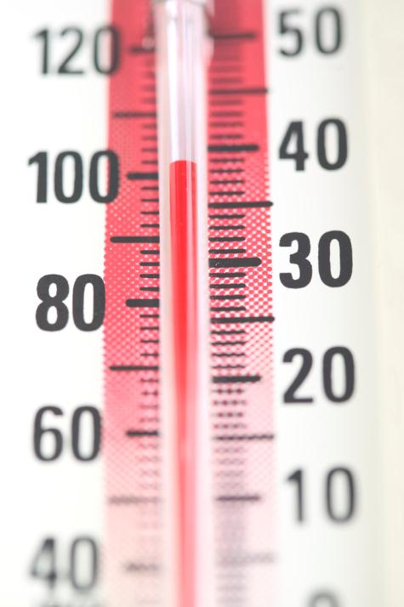
Why Temperature Varies
Temperature
Over
Time
The temperature in a certain location or place is influenced by four main factors.
1. latitude - the most important factor
The latitude is the angular distance,
expressed in degrees and minutes,
north or south of the equator.
2. proximity to a body of water
3. temperature of ocean currents
4. elevation above sea level

Slide 4
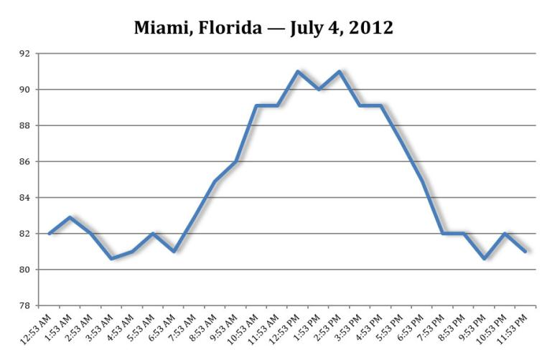
Latitude and the Seasonal Temperature
Temperature
Over
Time
Daily air temperatures at Earth’s surface are controlled by the incoming and outgoing energy.
During the day, the air temperature increases as energy gains exceed the energy lost from Earth’s surface.
Throughout the night, the air temperature decreases as Earth’s surface loses more energy than it receives.
Both the angle of the sun’s rays and the number of daylight hours in a location change throughout the year as Earth orbits or revolves around the sun.

Slide 5
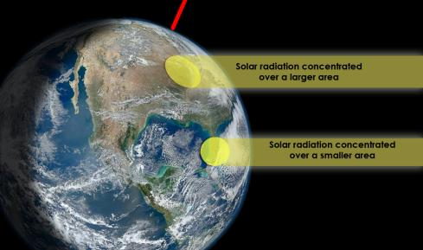
Angle of Solar Radiation and Temperature
Temperature
Over
Time
The angle of incoming solar radiation influences solar radiation at different latitudes.
Near the equator, the sun’s rays
are nearly perpendicular (at a 90° angle)
and concentrated over a smaller surface
area (Causing warmer temperatures)
At higher latitudes, the angle of the sun’s
rays is lower and energy is spread over a larger surface area (causing cooler temperatures)

Slide 6
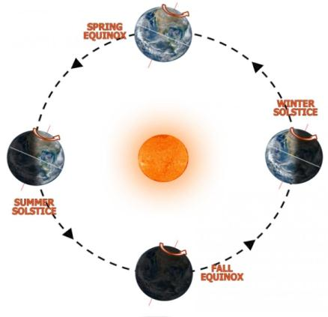
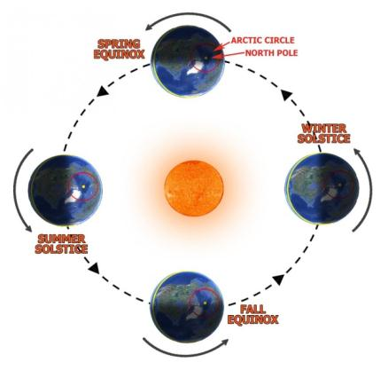
The Seasons
Temperature
Over
Time
Earth takes 365 and ¼ (6 hours) days to complete one revolution around the sun.
To keep our calendars synchronized with the planet’s actual orbit, every 4 years we add an extra day to the month of February – 4 quarters of a day (1 quarter each year for 4 years) equals 1 day or 24 hours.
People often mistakenly think that the different seasons are caused by a change in Earth’s distance from the sun. This is a misconception because Earth’s orbit is only slightly elliptical and our planet is nearly the same distance from the sun all year long.
The combination of more direct rays of sunlight and more hours of daylight causes the hemisphere tilted toward the sun to receive more solar radiation and to have warmer temperatures.

Slide 7
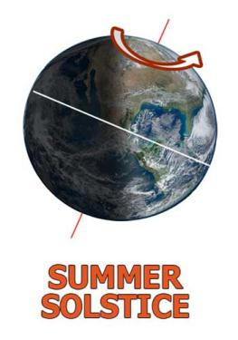

Summer Solstice
Temperature
Over
Time
The summer season begins in the Northern Hemisphere on June 20 or 21, known as the summer solstice, when the axis of rotation is tilted a full 23.5° toward the sun.
The incoming solar radiation strikes Earth directly at a perpendicular or 90° angle to the 23.5°N parallel of latitude.
The North Pole has 24 hours of daylight from spring to fall equinox and the South Pole has 24 hours of darkness during that period.

Slide 8
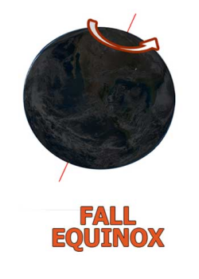

Fall Equinox
Temperature
Over
Time
Fall or autumn in the Northern Hemisphere begins September 22 or 23. In the Southern Hemisphere, spring begins on this day.
On the first day of fall, Earth is neither tilted toward nor away from the sun, causing the length of daylight and nighttime hours to be equal (12 hours) in both hemispheres.

Slide 9
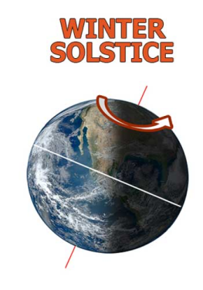

Winter Solstice
Temperature
Over
Time
Winter in the Northern Hemisphere begins on December 21 or 22, when the axis of rotation is tilted a full 23.5° away from the sun.
On this day, known as the winter solstice, the incoming solar radiation strikes Earth directly at a perpendicular or 90° angle to the 23.5°S parallel of latitude, known as the Tropic of Capricorn.
The North Pole has 24 hours of darkness, whereas the South Pole has 24 hours of daylight.

Slide 10
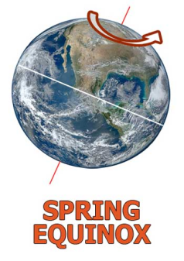

Spring Equinox
Temperature
Over
Time
Spring in the Northern Hemisphere begins on March 20 or 21 when Earth is again not tilted toward or away from the sun.
On this day, known as the spring equinox, there are 12 hours of daylight and 12 hours of darkness in both hemispheres.
Fall begins on March 20 or 21 in the Southern Hemisphere.

Slide 11
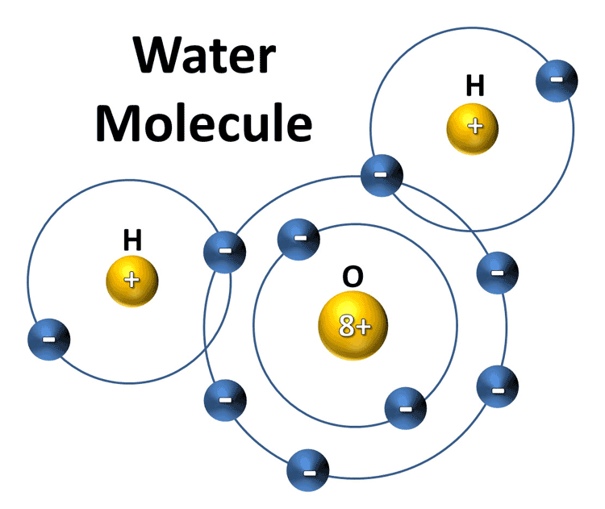
Properties of a water molecule
Temperature
Over
Time
One unique property of water is its high heat capacity – the highest of all liquids other than liquid ammonia.
A water molecule consists of one oxygen (O) atom bonded to two hydrogen (H) atoms.
The “8+” refers to the atomic number of oxygen,
which is also the number of protons in the nucleus
and number of electrons in the energy levels
outside the nucleus.
The “+” refers to the atomic number of hydrogen,
which is the number of protons in the nucleus and
number of electrons in the energy levels outside
the nucleus.
The bonding between the oxygen atom and each hydrogen atom is known as covalent bonding because they share electrons (6 from oxygen and 2 from the 2 hydrogen atoms in the outer energy level) to make a very stable water molecule.
The two hydrogen atoms are bonded to the oxygen atom at a 105° angle, which causes water to be a polar molecule. The large oxygen atom causes this side to be negatively charged while the hydrogen side is negatively charged.

Slide 12
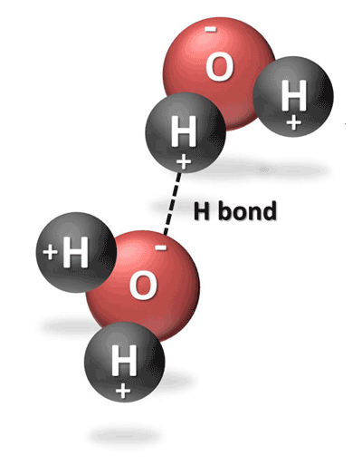
Water’s influence on temperature
Temperature
Over
Time
Water is a liquid rather than gas (or water vapor) at room temperature because of the strong hydrogen bond between the molecules of water. This strong bond causes water to resist molecular motion and remain a liquid at room temperature.
This means that it takes more energy or heat to increase water’s temperature than it does for most other substances.
Water also is fluid, allowing the heat to be mixed to greater depth than on land.
Oceans have a greater heat capacity than land because the specific heat of water is greater than that of dry soil and because a mixing of the upper ocean results in a much larger mass of water being heated than land.
This causes land areas to heat more rapidly and to higher temperatures
and also cool more rapidly and to lower temperatures, compared to
oceans.
The high heat capacity of water keeps its temperature within a relatively narrow range, causing nearby coastal areas to also have a narrow daily and seasonal temperature range. In contrast, areas with similar weather conditions that are farther from the coast tend to have a much wider range of seasonal and daily temperatures.

Slide 13
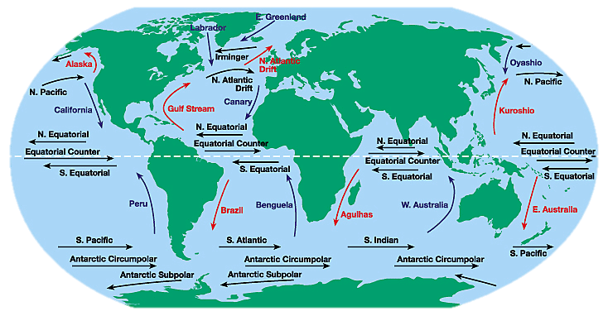
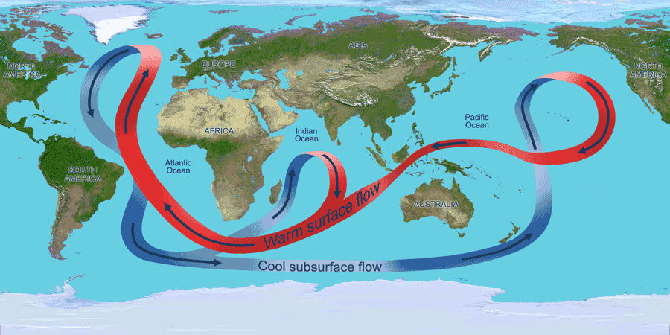
Ocean Currents
Temperature
Over
Time
Areas near the equator receive more direct solar radiation than areas near the poles.
These areas do not get continually warmer and warmer, because the ocean currents and winds transport the heat from the lower latitudes near the equator to higher latitudes near the poles.
The global wind patterns cause the surface currents to form in the uppers layer of the ocean. Where these winds blow in the same direction for long periods of time, large currents develop and transport vast amounts of water over long distances.
Large quantities of heat can be absorbed and stored in the surface layers of the ocean. This heat is transported by both the surface currents and deeper density-driven ocean currents. In this way, the both the surface and deep ocean currents help regulate Earth’s climate by facilitating the transfer of heat from warm tropical areas to colder areas near the poles.

Slide 14
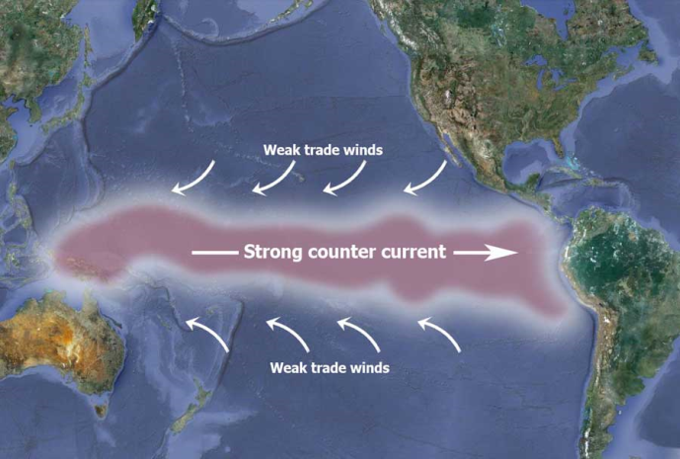
El Niño-Southern Oscillation (ENSO)
Temperature
Over
Time
The El Niño-Southern Oscillation (ENSO) is a cycle of changing wind and ocean current patterns in the Pacific Ocean.
Normally, warmer water is transported westward in the Pacific Ocean by the southeast trade winds until it accumulates near Indonesia. This warm water in the western Pacific Ocean causes low air pressure and high rainfall.
Every 3 to 10 years, the southeast trade winds weaken, allowing the warm water to flow further eastward toward South America. This is known as an El Niño phase.
An El Niño warm-water phase changes global weather patterns.
South America experiences wetter than average
weather while North America experiences mild, but
stormier winter weather.
There are fewer and less intense hurricanes in the
Atlantic Ocean.
Sometimes, after an El Niño subsides, a colder-than-normal water phase, known as La Niña, results.

Slide 15
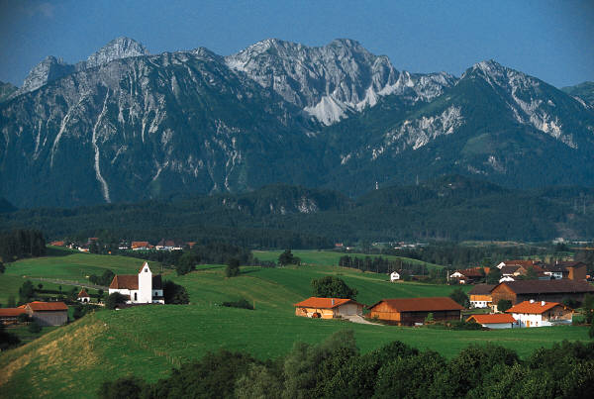
Elevation
Temperature
Over
Time
Air temperature is also affected by the elevation of a location.
Temperature normally decreases as elevation or height increases, making locations at higher elevations colder
For every 100-meter increase in elevation, the average temperature decreases by 0.7°C.

Slide 16
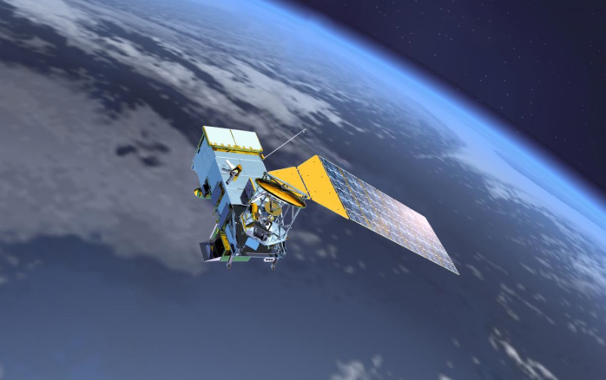
Methods for measuring recent temperatures
Temperature
Over
Time
Earth’s global mean temperature (GMT) is determined by averaging measurements of air temperatures over land ocean surface temperatures.
Surface temperature is measured not only by thermometers at ground-based weather stations and on ships, but also by satellites and weather balloons
Thousands of weather stations spread over land surface worldwide measure the local air temperatures while thousands of ships and buoys measure the local sea surface temperatures.
These measurements are combined so
that every square kilometer counts
equally toward global mean temperature.

Slide 17
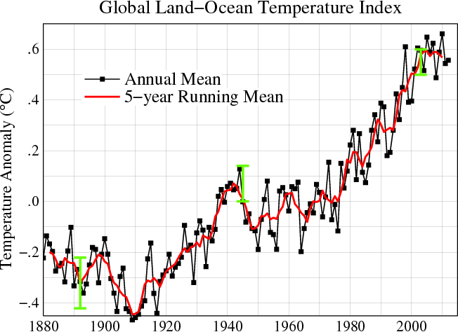
Temperature Anomalies
Temperature
Over
Time
Temperature trends over time are often shown as temperature anomalies. A temperature anomaly is a departure from the long-term average.
A positive temperature anomaly means that the temperature was warmer than the long-term average, and a negative temperature anomaly means that the temperature was cooler than the long-term average
Thermometer records have been kept for the past 150 years over much of Earth. By averaging these records, it is possible to estimate global mean temperature back to the mid-19th century.

Slide 18
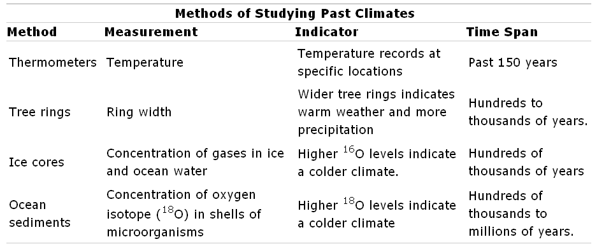
Methods for Studying Past Temperature
Temperature
Over
Time
To reconstruct climate history, scientists use proxy data – records used to infer atmospheric properties such as temperature and precipitation.
This subfield of climate science is referred to as paleoclimatology.
Historical documents, such as personal diaries, mariner’s logs, records of harvests and quality of wines, can provide indirect indications of past climate. These written documents, however, are not as reliable as the other proxy data sources described below.

Slide 19

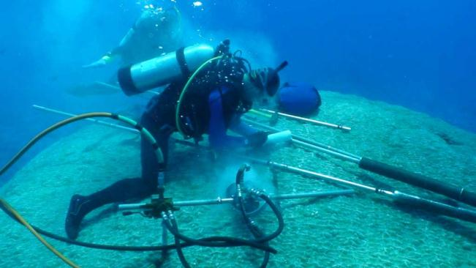
Tree Rings and Coral Reefs
Temperature
Over
Time
Tree rings and coral reefs indicate past growth rates.
Each tree ring indicates a year of growth. Trees tend to grow faster in warm and moist years.
The Lost Colony
Analyses of tree ring growth data also help scientists reconstruct past drought records. In the 1580s, the first English colony, known as the Roanoke colony or the Lost Colony, disappeared from the North Carolina coast. Persistent drought in late 16th and early 17th centuries may have contributed to colonists’ disappearance.
Scientists can extract cores from coral, and the coral growth rings can be used to reconstruct past climate in the tropical and subtropical regions.
Corals grow faster in warmer waters.
Image Credit: Wikipedia

Slide 20
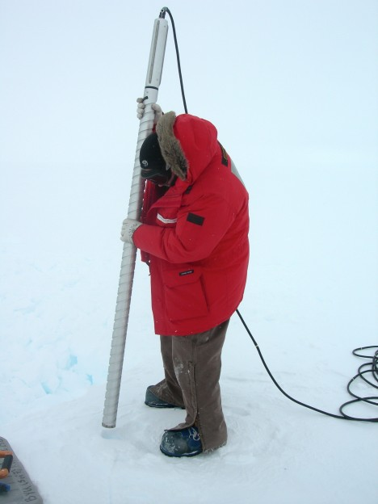
Ice Cores
Temperature
Over
Time
Ice cores are cores about 10 cm (4 inches) in diameter that are drilled through kilometers (miles) of ice sheets – a large thick mass of glacial ice that forms from the accumulation of annual layers of snow.
The air between the original snowflakes is trapped
as the snow begins to accumulate. As more snow
falls, the buried snow is compressed and eventually
freezes. The trapped “air bubbles” provide a
historical record of the gases and even dust
particles in the atmosphere at the time the snow
fell. The deepest core samples contain the oldest air.
By the 1990s, the United States and Europe had drilled through the summit of Greenland’s ice sheet to the bedrock to obtain about 200,000 years of climate data. And by 2008, the European Project for Ice Coring in Antarctica (EPICA) was able to reconstruct about 800,000 years of climate data.
To reconstruct the air temperature from an ice core, scientists analyze the air trapped in the ice using either of two methods – the oxygen isotope ratio or the deuterium to hydrogen ratio.

Slide 21
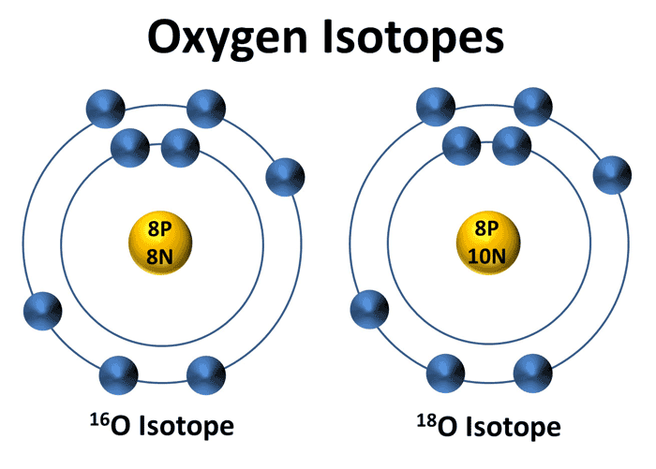
Isotope Ratios
Temperature
Over
Time
The oxygen isotope ratio is one way used to determine past temperatures from the ice cores.
Isotopes are atoms of the same element that have a different number of neutrons.
All isotopes of an element have the same number of protons and electrons, but a different number of neutrons in the nucleus.
Depending on the climate, the two types of oxygen (¹⁶O and ¹⁸O) vary in water.
More evaporation occurs in warmer regions of the ocean, and water containing the lighter ¹⁶O isotope evaporates more quickly than water containing the heavier ¹⁸O.
Water vapor containing the heavier ¹⁸O, however, will condense and precipitate more quickly than water vapor containing the lighter ¹⁶O.
Go to the next slide for review of the water cycle.

Slide 22
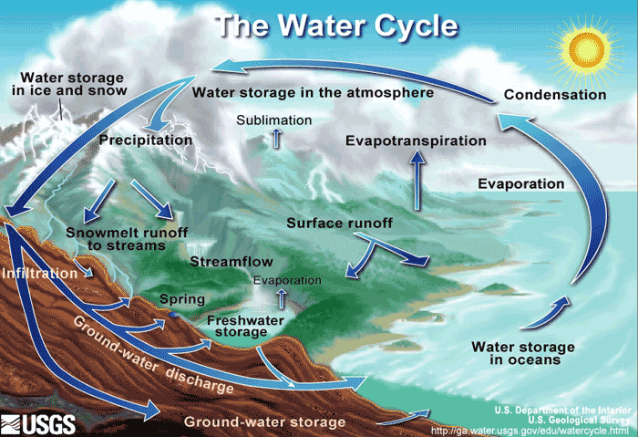
The Water (Hydrologic) Cycle
Temperature
Over
Time
The water or hydrologic cycle is the constant exchange of water in its various forms of liquid, solid (ice and snow), and gas (water vapor) between the earth, the oceans, and the atmosphere.
The sun provides energy to drive the system as it heats Earth, causing evaporation of liquid water. Water evaporates from the surface of all the bodies of water on Earth. The water vapor rises with the less dense warm air.
As the air containing water vapor moves farther away from Earth's surface, it cools. Cool air cannot hold as much water vapor as warm air. In cooler air, most of the water vapor condenses into droplets of water that form clouds.
Precipitation falls toward Earth when the water droplets that form in clouds become too heavy to stay in the air.
When precipitation reaches Earth, it either evaporates or flows over the surface (known as runoff) where it may accumulate in ponds or lakes or eventually reach streams, rivers, and the ocean.

Slide 23
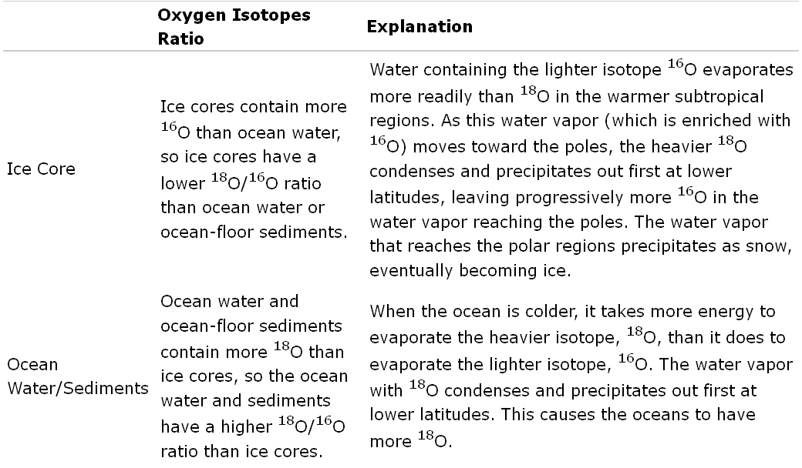
The Isotope Ratio for Colder Climates
Temperature
Over
Time
Ocean-floor sediments can also be used to determine past climate. They reflect the oxygen isotope of the ocean water, because the oxygen in the calcium carbonate shells that are deposited on the ocean floor records the oxygen isotope variations in the ocean at the time of formation.
Oxygen Isotope Ratios for Ice Cores and Ocean Water/ Sediments During a Colder Climate

Slide 24
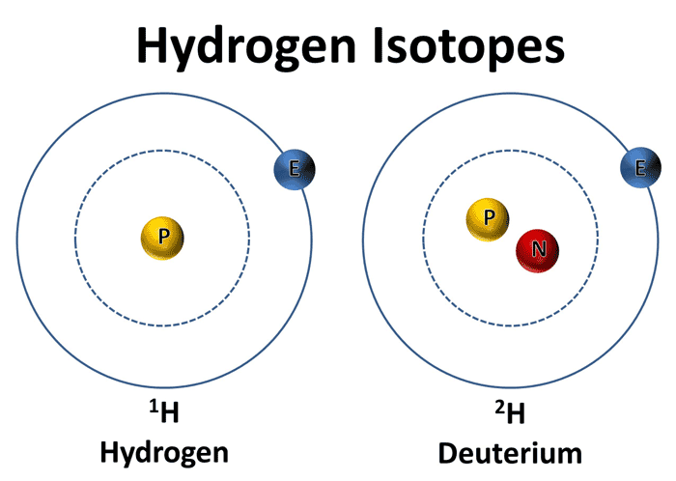
The Deuterium to Hydrogen Ratio
Temperature
Over
Time
A second way to determine past temperatures is by calculating the deuterium to hydrogen ratio in the ice core samples.
The water molecule contains two different isotopes of hydrogen (¹H and ²H).
¹H contains one proton and no neutrons and ²H, known as deuterium or D, contains one proton and one neutron.
The ratio of deuterium to hydrogen in the ice core is compared to the ratio of deuterium to hydrogen in standard mean ocean water.
The ice cores contain slightly less of the heavier isotopes of oxygen (¹⁸O) and deuterium (²H).

Slide 25
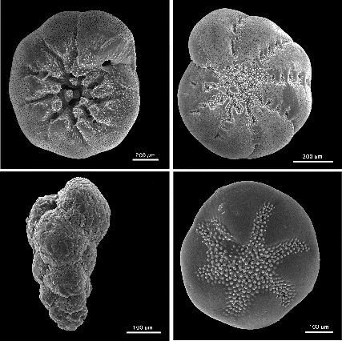
Ocean Sediments
Temperature
Over
Time
The deep ocean floor provides another clue of what was happening in the atmosphere and in the oceans at the time the sediments were deposited.
Sediment cores extracted from the ocean floor provide a continuous record of sedimentation dating back many hundreds of thousands of years and even millions of years in certain places.
A sediment core from the equatorial eastern Pacific Ocean reveals the climate history as far back as 5 million years.
This analysis is possible because microscopic marine organisms, such as foraminifera, are found in ocean floor sediments. They obtain their oxygen content from seawater to make carbonate shells. In a colder climate, the shells would contain more of the heavier ¹⁸O isotope.

Slide 26
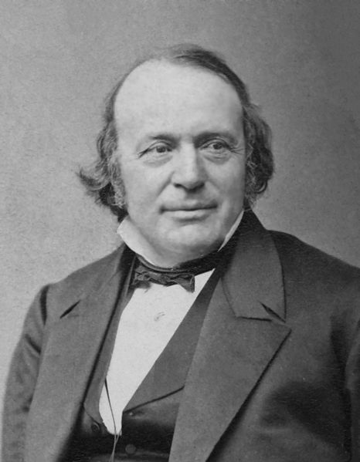
Temperature Change Over Geologic Time
Temperature
Over
Time
Global mean temperature (GMT) has been 8° to 15°C warmer than today with polar areas free of ice, and GMT has been 5° to 15°C cooler in mid-latitudes with continental glaciers – some as thick as 1 mile covering areas as far south as New York City.
Louis Agassiz (1807-1883) was a young professor who studied fossil fish.
Agassiz proposed that a giant ice sheet once covered large areas of Earth. His classic Studies on Glaciers (1840) gave rise to a new field of research.

Slide 27
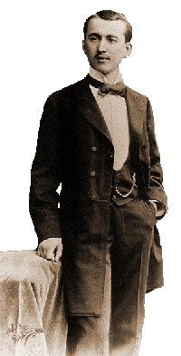
The Causes of Glaciation
Temperature
Over
Time
Milutin Milankovitch (1879-1958) was a Serbian mathematician who, for more than 25 years, worked on producing the first numerical estimates of the effect of variations in Earth’s orbit on the latitudinal and seasonal variations in solar radiation.
The Milankovitch Theory explains the 3 cyclical changes in Earth’s orbit and tilt that cause the climate fluctuations occurring over tens of thousands of years to hundreds of thousands of years.
These fluctuations include changes in the shape (eccentricity) of Earth’s orbit, the tilt (obliquity) of Earth’s axis, and the wobbling (precession) of Earth’s axis.
The interplay of these three cyclical changes affects the amount of solar radiation that Earth receives at different latitudes and during different seasons.

Slide 28
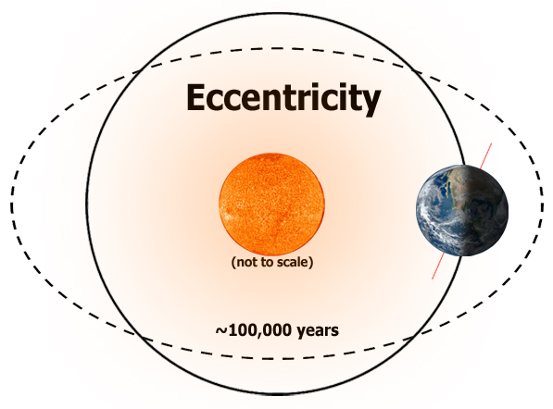
eccentricity
Temperature
Over
Time
Earth’s orbit can be nearly circular, as it is presently, or more elliptical.
This orbital change from circular to more elongated, is known as eccentricity and takes about 100,000 years to go from nearly circular to elliptical and back to nearly circular in shape.
When the orbit is more circular, as it is now, there is less variation in the distance between the sun and Earth. When the orbit is more elliptical, glaciation is affected by the time of year (season) that Earth is closest to the sun.

Slide 29
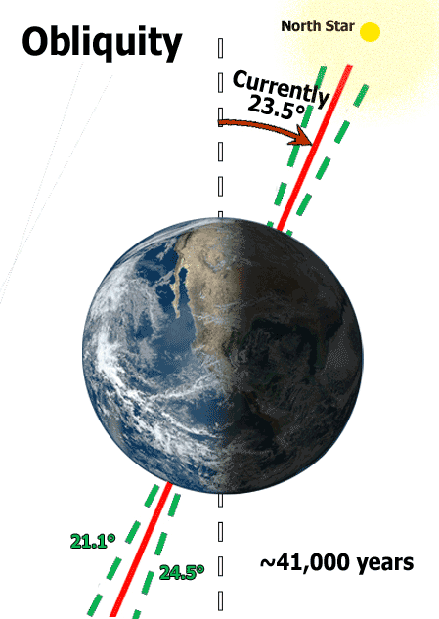
obliquity
Temperature
Over
Time
The tilt of Earth’s axis, known as obliquity, which varies between 22.1° and 24.5° every 41,000 years.
As you have learned, Earth’s axis is currently tilted 23.5°. When the tilt is less, the winters are not as cold and the summers are not as warm.
Warmer air can hold more water vapor and therefore, produce more snow during the winter months.
Because the summers are not as warm, the previous winter’s snow does not melt. This promotes glacier formation.

Slide 30
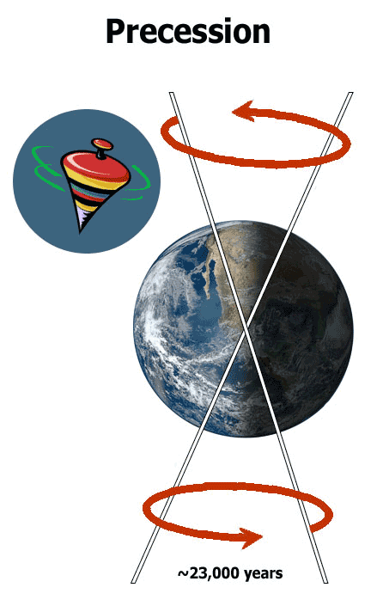
precession
Temperature
Over
Time
The third cyclical change is in Earth’s axis. Each 24 hours, Earth rotates once around its imaginary axis.
About every 23,000 years, the axis itself also makes a complete circle or precession, causing Earth to “wobble.” This “wobble,” causes Earth to be closer to the sun in July instead of January and intensifies the summer temperatures in the Northern Hemisphere.
Because the Northern Hemisphere has more landmasses at higher latitudes where ice sheets can form and grow, the position of this hemisphere is important.

Slide 31
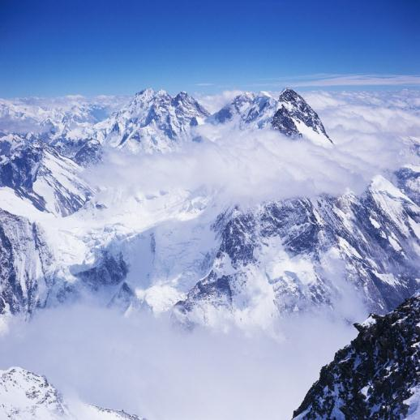
The Meaning of an “Ice Age”
Temperature
Over
Time
Throughout much of Earth’s geologic history, the global mean temperature was between 8°C and 15°C warmer than it is today with polar areas free of ice.
These relatively warm periods were interrupted by cooler periods, referred to as ice ages. A decrease in average global temperature of 5°C may be enough start an ice age.
The term “ice age” is misleading –– an “ice age” is actually a long period of climatic cooling, during which continents have repeated glaciations (glacial periods) interspersed with interglacial periods.
During a glacial period, continental ice sheets, polar ice sheets and
alpine glaciers are present or expand, sometimes covering as much
as 30% of the continental landmasses.
During an interglacial period, the climate is warmer and glaciers
melt and retreat, and ice may cover less than 10% of Earth’s land
surfaces.
During an ice age, climate fluctuates between glacial periods lasting tens of thousands of years and shorter interglacial periods.
Several ice ages have occurred over Earth’s geologic history, and there is evidence of at least five major ice ages over the past 4.6 billion years.

Slide 32
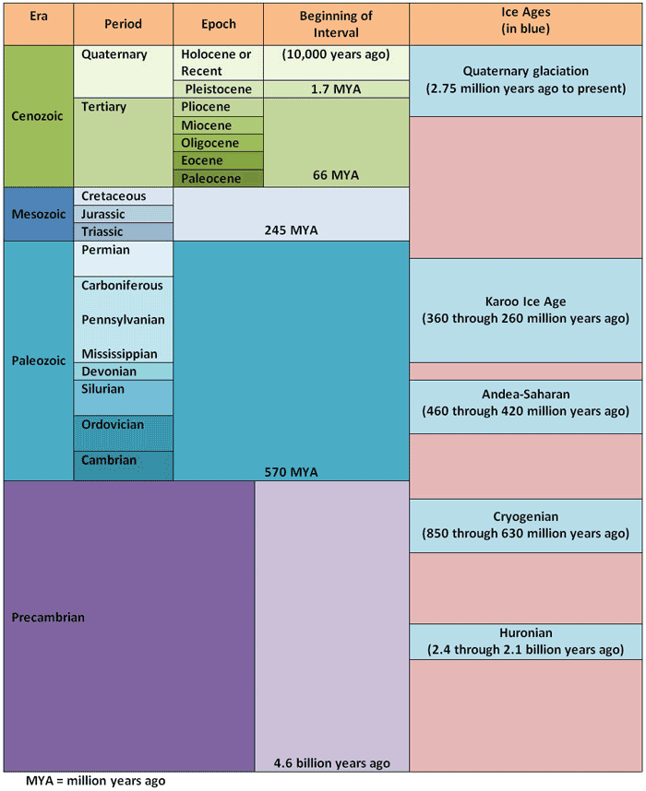
Climates of the Past
Temperature
Over
Time
Approximately 55 million years ago, Earth entered a long cooling trend due mostly to a decrease in the concentration of carbon dioxide in the atmosphere.
The most recent ice age began about 2.75 million years ago. This marked the beginning of the Pleistocene epoch. This epoch is characterized by periods of glaciation and warmer periods or interglacial periods.
At the present time, Earth is in an interglacial period within the most recent ice age.

