Slide 1
The Nature of Science

Slide 2
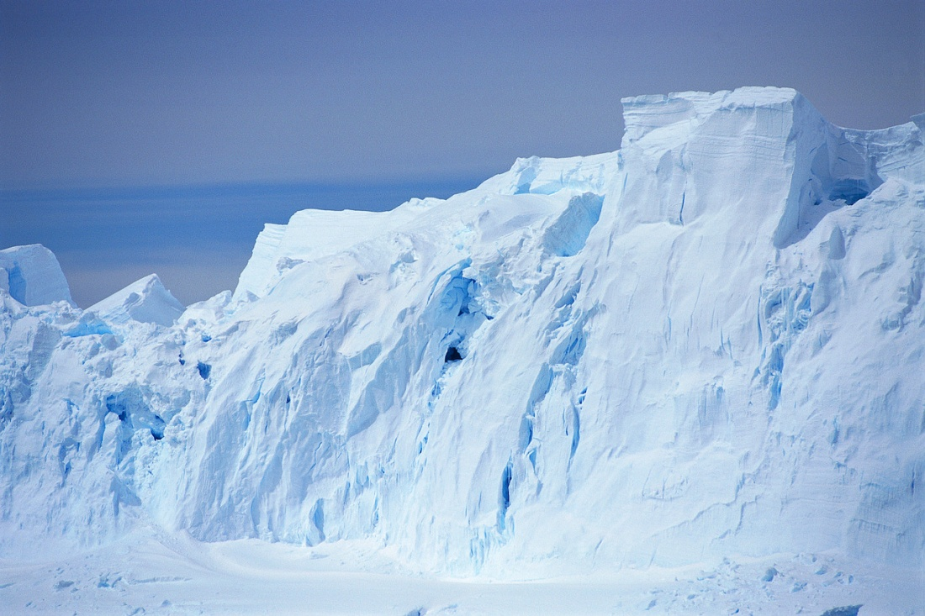

THE NATURE OF SCIENCE
Similarities and Differences between Climate Science and Crime Scene Investigators
Similarities
Both observe and record changes in variables.
Both use the latest technology to collect and analyze the data that they find.
Differences
Crime scene investigations are limited to particular events that occurred on specific dates.
Climate scientists not only must collect and analyze information related to current climatic conditions on Earth, they also must hunt for clues or proxy data before humans kept written records.

Slide 3
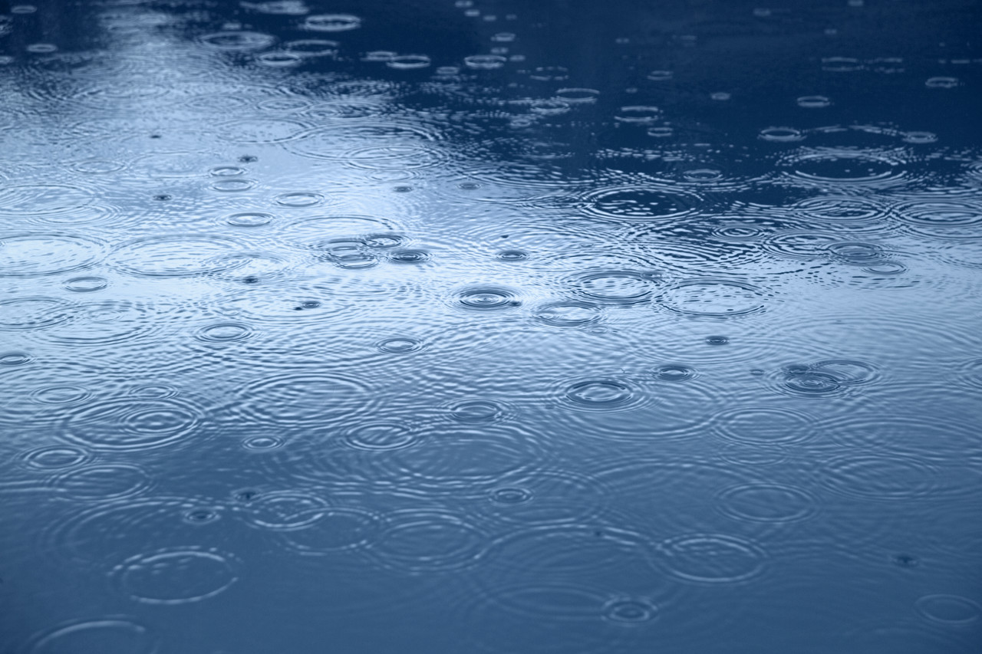
Is a climate scientist a meteorologist?
THE NATURE OF SCIENCE
A climate scientist is not a meteorologist.
Meteorologists are the scientists who observe and predict weather (the atmospheric conditions and events at a given time for a given place).
Climate scientists study weather patterns over long periods of time (ranging from decades to millennia). Climate scientists also analyze patterns and learn how different elements of Earth’s climate system interact and influence each other.

Slide 4
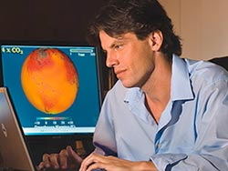
The Importance of climate scientists
THE NATURE OF SCIENCE
With the growing body of knowledge that explains how our climate system works, climate scientists can make increasingly reliable predictions about our climate (the long-term atmospheric conditions and trends for specific regions and the planet as a whole).
Ultimately, scientists hope that climate research will help humanity select and use resources wisely and protect the fragile environment on which all our lives depend.
Dr. Brian Soden, Climate Scientist at the Rosenstiel School of Marine and Atmospheric Science, University of Miami

Slide 5
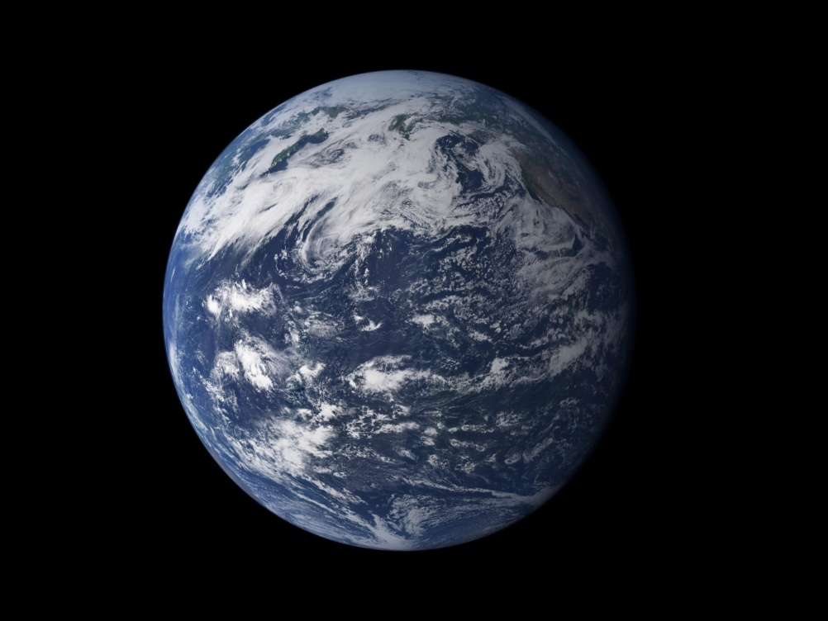
Climate Science Investigations: South Florida
THE NATURE OF SCIENCE
CSI: South Florida will help you investigate many of the variables involved in Earth’s climate system.
As you proceed on your journey through the modules, you will understand some of the causes of climate change, the rate at which these changes may occur, and whether the consequences are predicted to be significant enough to warrant changes in public policy and human lifestyles.

Slide 6
What You Will Be Able To Do After This Module
THE NATURE OF SCIENCE
Explain the nature of scientific inquiry.
Differentiate between science and other ways of knowing.
Explain the variety of methods that scientists use to revise and produce new knowledge.
Describe the components of an evidence-based scientific argument.
Explain the role of skepticism in scientific inquiry.
Explain how the scientific community reaches consensus about certain findings and explanations.
Provide an example of international collaboration among climate scientists.
Explain how theories are developed.

Slide 7

Science as a way of knowing
THE NATURE OF SCIENCE
Science refers to the system or process of acquiring knowledge about the natural world.
To study the natural world, scientists use methods that are empirical, which means that they are grounded in observations and experimentation and are not based on opinions or feelings.
Scientific inquiry refers to activities and practices involving scientists’ pursuit of knowledge.
Science as a way of knowing refers to the belief that the actions of science are based on logic, evidence and reasoning.

Slide 8

What Do Scientists Assume?
THE NATURE OF SCIENCE
Scientists have a certain worldview about science and their work. Their activities and practices are guided by the following assumptions:
The physical world is understandable.
Science cannot provide the answers to all questions.
Scientific knowledge is durable, but it does not represent absolute truth.
Scientific ideas are tentative (or subject to change).

Slide 9


What Makes Science Different From Other Ways of Knowing?
THE NATURE OF SCIENCE
Science is based on empirical research.
Empirical research relies on systematic observation and experimentation, not on opinions and feelings.
Systematic observations and experiments provide research results that must meet two criteria in order for a scientist’s research to withstand thorough questioning.
Validity means that research is relevant to the question being asked.
Reliability describes the repeatability or consistency of the research.

Slide 10


Who Are Scientists and How Do They Decide What To Study?
THE NATURE OF SCIENCE
Scientists come from all backgrounds and all parts of the globe. Their diversity allows them to look at problems from a variety of perspectives and search for answers in different ways.
Because science and the body of scientific knowledge is so broad, most scientists specialize — just as one doctor decides to become a pediatrician, while another chooses to be a brain surgeon.
Scientists often spend their entire career studying a specific topic and thus may not be qualified to evaluate the results of scientists who are working in other fields of study.

Slide 11



Comparing the work of scientists and detectives
THE NATURE OF SCIENCE
Scientists, like detectives, work to reveal and explain the unknown, and their inquiry methods share some similarities.

Slide 12
The Difference between Scientific and Crime Scene Inquiry
THE NATURE OF SCIENCE
In our legal system, a jury or judge makes a decision about which side is correct. Once the decision is made, it is usually final because a person can be forced to stand trial only once for a particular crime.
The scientific community, however, considers multiple hypotheses to explain the same phenomenon, and scientific inferences are always open to reevaluation by other scientists.

Slide 13
Why Do Scientists Argue and Challenge Each Other’s Results?
THE NATURE OF SCIENCE
The back-and-forth debates among scientists may sometimes be confusing to the public, but these challenges and serve a very useful and necessary purpose in advancing scientific knowledge.
By using empirical methods, scientists are able to reexamine evidence and data, repeat experiments, replicate research results, and confirm (or reject) explanations.
Scientists want other scientists in the same field of study to review their methods and challenge their results because the public and the scientific community will have confidence in their explanations only after other qualified scientists have judged their work to be valid.

Slide 14
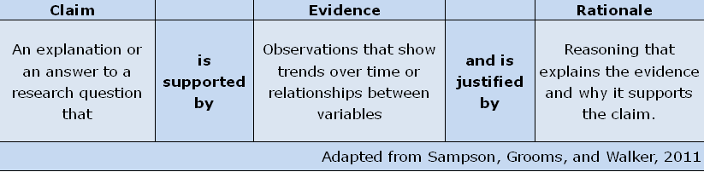
What Is a Scientific Argument?
THE NATURE OF SCIENCE
A scientific argument is defined as people disagreeing about scientific explanations (claims) using empirical data (evidence) to justify their side of the argument.
Scientists identify weaknesses and limitations in others’ arguments, with the ultimate goal of refining and improving scientific explanations and experimental designs. This process is known as evidence-based argumentation.
Scientific argumentation requires scientists to support their claims with evidence that has been gathered through observation or experimentation and then to use logic and reason to justify why that evidence supports their claims.
Scientific arguments use evidence and data rather than belief or opinion to support a claim because evidence and data can be empirically reexamined and retested, whereas beliefs and opinions cannot be empirically verified.

Slide 15
Why Must Scientists Be Skeptics?
THE NATURE OF SCIENCE
Skepticism is the act of suspending judgment (the opposite of jumping to conclusions) when evaluating an explanation or claims.
Being skeptical allows scientists to consider all possibilities and systematically question all information in the course of an investigation.
Skepticism helps scientists to remain objective when performing scientific inquiry and research. It forces them to examine claims (their own and those of others) to be certain that there is sufficient evidence to back them up.
Skeptics do not doubt every claim, only those backed by insufficient evidence or by data that have been improperly collected, are not relevant, or cannot support the rationale being made.

Slide 16
What Is the Difference Between Skepticism and Denial?
THE NATURE OF SCIENCE
Skepticism allows scientists to reach logical conclusions supported by evidence that has been examined and confirmed by others in the same field, even when that evidence does not confirm absolute certainty.
Denial is the act of clinging to an idea or belief despite the presence of overwhelming evidence to the contrary.
Science works to determine the statistical probability of a claim’s accuracy, not its certainty.
Denial can be counter-productive by preventing appropriate planning and timely action that might delay or lessen the severity of the changes.
“Skepticism is healthy both in science and society; denial is not.”
(Washington & Cook, 2011, p.2)

Slide 17

How Do Scientists Collaborate and Reach Consensus?
THE NATURE OF SCIENCE
Challenging other scientists’ explanations of natural phenomena may seem unfriendly, but it is actually a form of collaboration (working together).
Reviewing and questioning scientists’ methods, data, and findings, allows scientists not only improve their work, but also to communicate more effectively.
The peer-review process serves as a quality-control check before scientific research is published.

Slide 18
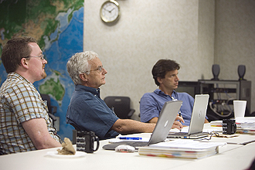
The Scientific Peer Review Process
THE NATURE OF SCIENCE
The Peer Review Process
Scientists submit their research in the form of an article (or paper) to a scientific journal.
Scientists in related fields (peers) read and evaluate the submitted article. They recommend changes to the author(s) that would improve the article or research.
The scientists make the recommended changes or explain why they did not.
Once papers are presented at conferences or are published, the wider scientific community has an opportunity to review and challenge the research.
When the work being reviewed can be repeated and confirmed, the scientific community is likely to reach consensus (agreement) and accept the findings and explanations as valid. If scientists cannot confirm or validate the research, those explanations or ideas are likely to be challenged, or even rejected.
Acceptance of an explanation ultimately depends on which one best explains the most observations. This peer review process is how scientific knowledge accumulates over time.

Slide 19
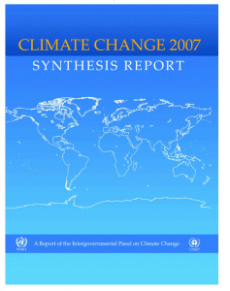
Intergovernmental Panel on Climate Change (IPCC)
THE NATURE OF SCIENCE
One example of extensive and international collaboration among scientists is the Intergovernmental Panel on Climate Change (IPCC).
The panel is divided into three working groups that include over a thousand scientists from all over the globe.
Working Group I assesses the latest understanding of the science of climate change.
Working Group II assesses the potential effects of climate change on both natural and socioeconomic systems.
Working Group III analyzes the options for avoiding (or mitigating, limiting, or offsetting) the effects of climate change.
IPCC scientists read the most current peer-reviewed, published scientific papers on climate change and assess these findings in comprehensive reports that are published approximately every 6 years.

Slide 20
How Are Scientific Theories Developed?
THE NATURE OF SCIENCE
Reaching consensus allows scientists to blend together the accepted findings of scientific research that have occurred over time.
A scientific theory is the end product drawn from comprehensive research, which combines all the most current, valid evidence to explain a wide range of phenomena (scientific observations). A scientific theory represents the most powerful explanation that scientists have to offer.
Is It a Law or a Theory?
Scientific laws describe specific relationships under given conditions in nature, but they do not explain those relationships. Sir Isaac Newton’s third law of motion — For every action, there is an equal and opposite reaction — is a good example. Thus, laws are well-supported descriptions, whereas theories are well-supported explanations. One important point to remember is that theories do not become laws, and laws do not become theories.

Slide 21
How Certain Is Science?
THE NATURE OF SCIENCE
The pursuit of science focuses on establishing probability rather than certainty. Scientists accept the fact that they are not all knowing and must remain objective and open to other possibilities when conducting scientific research.
Through the use of consensus-building activities — challenging others’ ideas, reexamining and retesting data, critiquing others’ work through the peer-review process — scientists have been able to build a body of knowledge about which we can be reasonably confident.
Science is, therefore, simultaneously durable enough to provide a reasonable basis for scientists to make logical conclusions about the world in which we live, and yet it is still flexible enough to be revised and improved when newer, better evidence and findings are discovered.

