Slide 1
Energy: The Driver of Climate

Slide 2
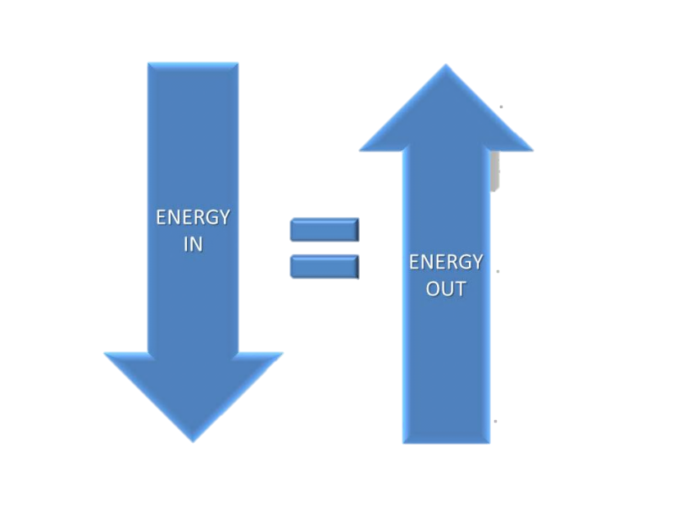
Overview
Energy: The Driver of Climate
The balance between incoming energy from the sun and outgoing energy from Earth ultimately drives our climate.
This energy balance is governed by the first law of thermodynamics, also known as the law of conservation of energy.
This law states that energy can be transferred from one system to another in many forms, but it cannot be created or destroyed. Therefore, any energy “lost” during one process will equal the same amount of energy “gained” during another.
When averaged over the course of a year, the incoming energy from the sun and outgoing energy from Earth are nearly in balance, keeping the average global temperature within the narrow range that supports and sustains life as we know it.

Slide 3
What You Will Be Able To Do After This Module
Energy: The Driver of Climate
Compare the composition of Earth’s early atmosphere to the present composition.
Compare and contrast the layers of Earth’s atmosphere.
Explain the relationship between wavelength and frequency of electromagnetic waves.
Analyze the sun’s electromagnetic spectrum to explain why different percentages of wavelengths reach Earth.
Use two fundamental laws (Stefan-Boltzmann law and Wien’s law) to explain the correlation between temperature and radiation for the sun and Earth.
Describe the three ways that heat energy is transferred within Earth’s atmosphere and between its surfaces and the atmosphere.

Slide 4
Energy: The Driver of Climate
What You Will Be Able To Do After This Module
Continued
Calculate Earth’s global radiation balance by analyzing the amount of incoming solar radiation and outgoing terrestrial radiation.
Explain why some greenhouse gases are more effective absorbers of infrared radiation.
Explain the relationship between Earth’s energy budget and the global average temperature of Earth.
Explain how the greenhouse effect works.
Differentiate between the natural greenhouse effect and an amplified greenhouse effect.

Slide 5
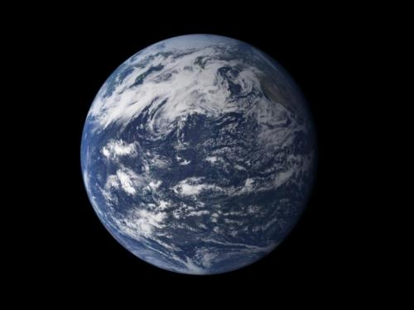
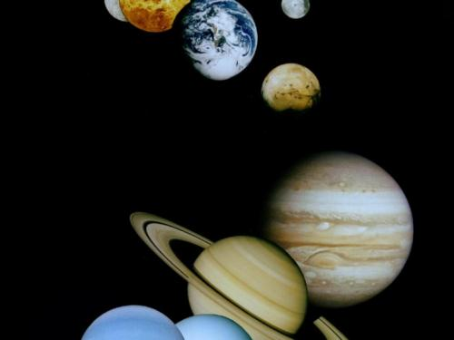
The Atmosphere
Energy: The Driver of Climate
With 71% of its surface covered by a relatively thin layer of water (some of it frozen), Earth is the only planet in our solar system that appears capable of supporting higher forms of life.
The other planets in our solar system have compositions and conditions very different from Earth’s.
Venus, for example, has an average temperature of 450°C due to its relatively thick atmosphere consisting mostly of carbon dioxide.
Mars has a thin atmosphere with a very small percentage of carbon dioxide, making it much colder than Earth.

Slide 6
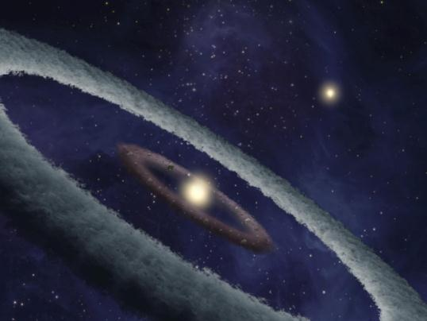

What Was Earth’s Ancient Atmosphere Like?
Energy: The Driver of Climate
Scientists theorize that a lot of debris or meteorites from space bombarded Earth, which caused the outer layer of Earth to melt. After the bombardment stopped, Earth began to cool.
As the molten surface became solid, gases were released into the atmosphere. These gases consisted mostly carbon dioxide (CO₂), with some nitrogen (N₂) and water vapor (H₂O), and other trace gases (methane, ammonia, sulfur dioxide, hydrochloric acid, and argon).
As Earth continued to cool, the water vapor condensed to form clouds, and great rains began. The oceans formed, and the amount of water vapor and carbon dioxide in the atmosphere, in turn, decreased, leaving Earth with a nitrogen-rich atmosphere.
Eventually, approximately 2.7 billion years ago, ancient organisms evolved to use carbon dioxide, water, and sunlight to make their food energy and release oxygen (known as photosynthesis).

Slide 7
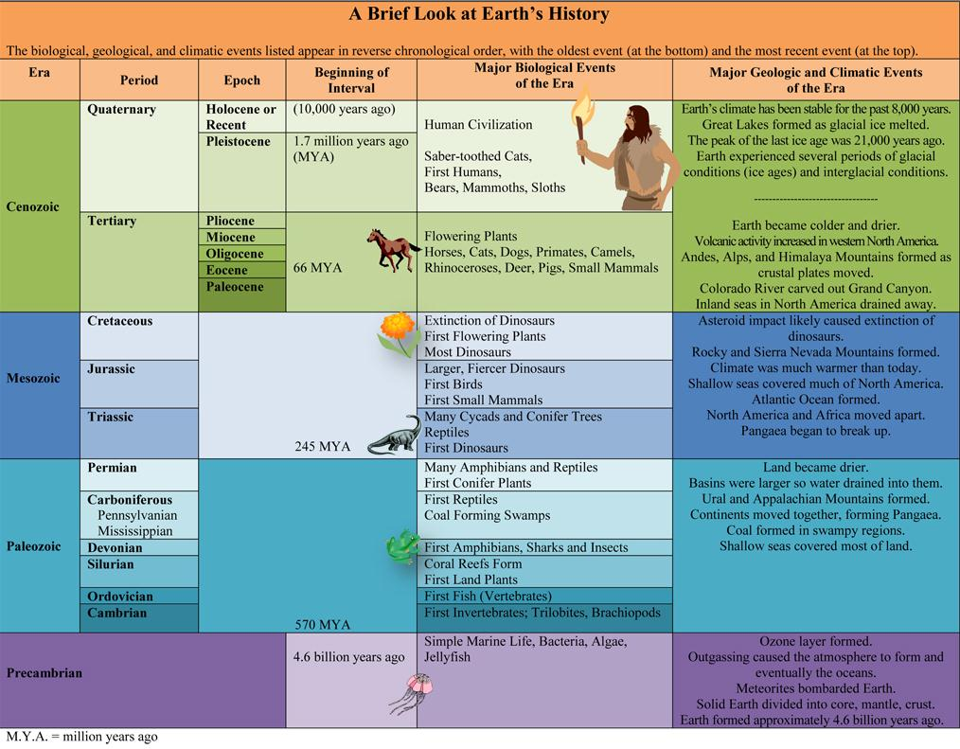
A Brief Look at Earth’s History
Energy: The Driver of Climate
The table shows Earth’s history over the past 4.6 billion years. The biological, geological, and climatic events appear in reverse chronological order.
Notice that the amount of time in each era, period, and epoch varies and that for most of Earth’s history, life was limited to simple marine organisms.

Slide 8
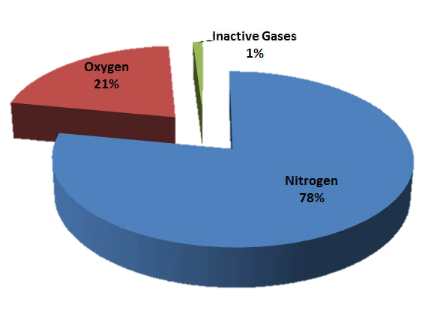
Which Gases Make Up
Earth’s Atmosphere?
Energy: The Driver of Climate
Earth’s relatively thin atmosphere primarily consists of a mixture of nitrogen (78%) and oxygen (21%) gases.
The remaining 1% contains several inactive gases (i.e., argon, neon, helium, hydrogen, and xenon) and several other gases that vary in concentration (i.e., water vapor, carbon dioxide, methane, nitrous oxide, ozone, and chlorofluorocarbons).
Although water vapor and carbon dioxide make up a very small amount of the gases in Earth’s atmosphere, they are very important because of their ability to absorb heat.

Slide 9
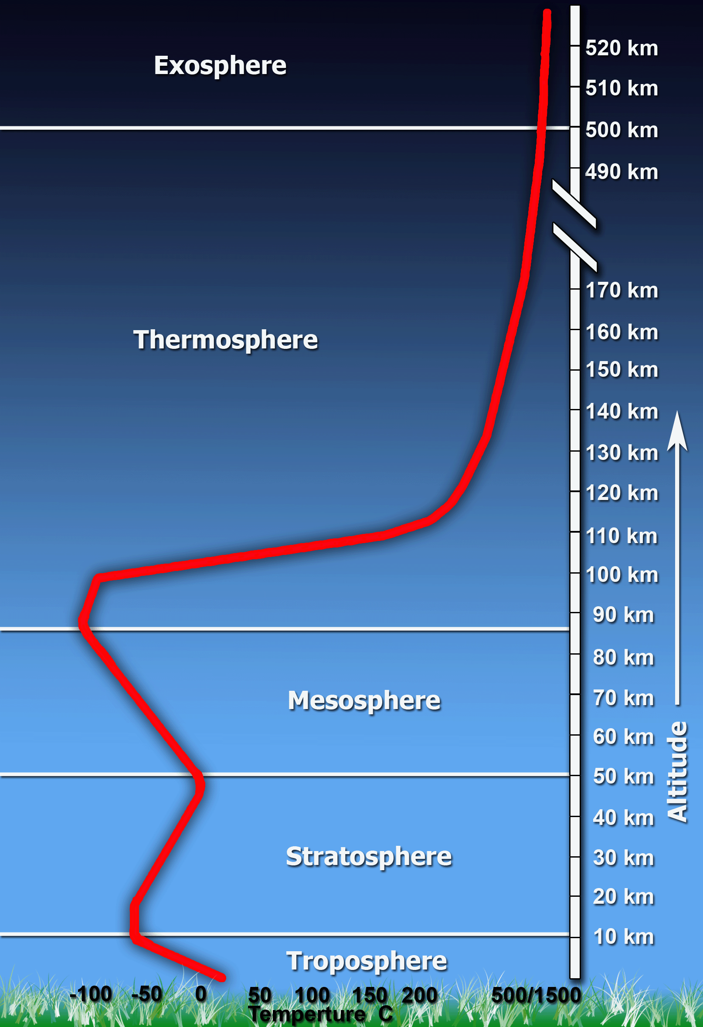
How is Earth's Atmosphere Structured?
Energy: The Driver of Climate
Earth’s atmosphere is relatively thin, extending up to at least 500 kilometers (300 miles) above the planet’s surface. The atmosphere is structured in different layers according mainly to variations in temperature.
Exosphere – outermost layer that extends to 10,000 kilometers (6,214 miles) above Earth’s surface. Atoms and molecules escape into space, and higher altitude satellites orbit Earth here.
Thermosphere - layer above the mesosphere and extends approximately 600 kilometers (373 miles). Temperature increases because of the absorption of UV and x-ray radiation and the impact of the solar wind. Low Earth orbit (LEO) satellites — like the International Space Station — circle our planet in the thermosphere.
Mesosphere – layer which extends to approximately 90 kilometers (56 miles) above the surface of Earth. Temperature decreases in part because of the low concentration of ozone (which absorbs solar radiation).
The lower layers (the stratosphere and troposphere) are described in more detail on the following slides.

Slide 10
The Stratosphere
Energy: The Driver of Climate
The stratosphere, extends from the troposphere upward to approximately 50 kilometers (31 miles) above Earth’s surface.
Ozone, a form of oxygen with three atoms per molecule, is concentrated in the stratosphere. Ozone absorbs most of the ultraviolet (UV) radiation coming from the sun, preventing this radiation from reaching Earth’s surface.
In the stratosphere, air temperature begins to increase. Why?
The absorption of UV radiation in this ozone layer causes temperature to increase, creating what is known as a temperature inversion — where air temperature increases with height rather than decreases, as it does in the troposphere.

Slide 11
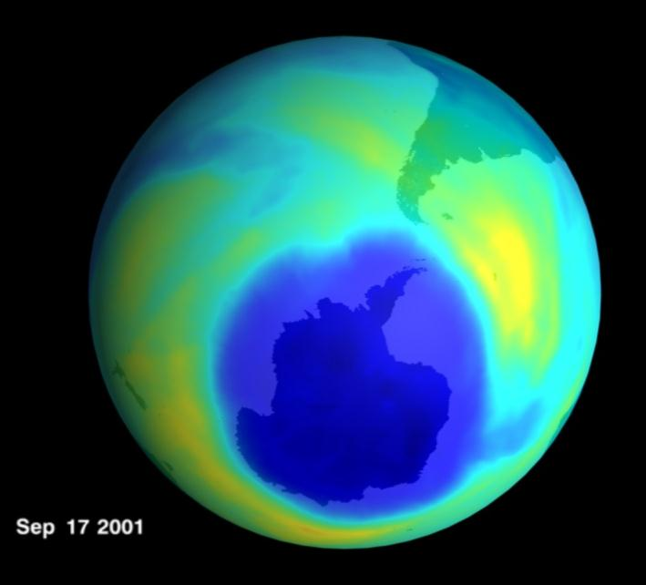
The Ozone Hole
Energy: The Driver of Climate
About 30 years ago, scientists discovered that the ozone layer was breaking down, so much that a large hole formed over Antarctica.
Chlorofluorocarbons (CFCs) were discovered to be the cause of the decrease in ozone. Man-made CFCs are used as coolants in air conditioners and refrigerators and in aerosol spray cans.
Most countries have stopped using the most harmful CFCs, and the concentration of ozone in the upper atmosphere is now increasing.

Slide 12
The Troposphere
Energy: The Driver of Climate
The lowest layer is known as the troposphere, which makes up approximately 75% of the total mass of the atmosphere and contains 99% of the atmosphere’s water.
The troposphere extends up to approximately 11 kilometers (7 miles) from the surface and is the layer where atmospheric gases are most concentrated.
Air temperature in the troposphere typically decreases as altitude increases as a result of three mechanisms of heat transfer (radiation, conduction, and convection).
Solar radiation passes through Earth’s atmosphere and heats up the planet’s surface. The oceans and land absorb approximately half of this incoming solar radiation while a small fraction is emitted back into the atmosphere as infrared radiation.
Consequently, the troposphere is generally warmest near Earth’s surface and coolest at its highest point.

Slide 13
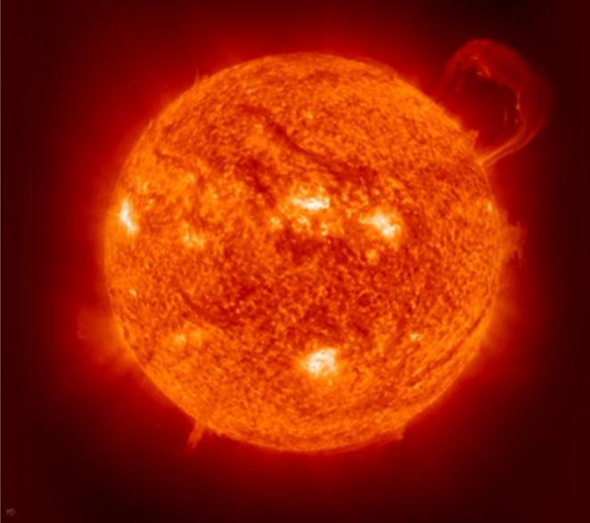
Radiation from the Sun
Energy: The Driver of Climate
Almost all of the energy available at Earth’s surface comes from the sun. The sun gets its energy from the process of nuclear fusion.
In this process, four hydrogen nuclei are fused, forming a helium nucleus. Energy is released because the helium nucleus has a slightly lower mass than the four original hydrogen nuclei.
This energy eventually makes its way to the outer regions of the sun and is radiated or emitted away in the form of energy, known as electromagnetic radiation
A particle of electromagnetic radiation is known as a photon. Electromagnetic radiation, also known as radiant energy (or radiation), is spread in the form of electromagnetic waves.

Slide 14
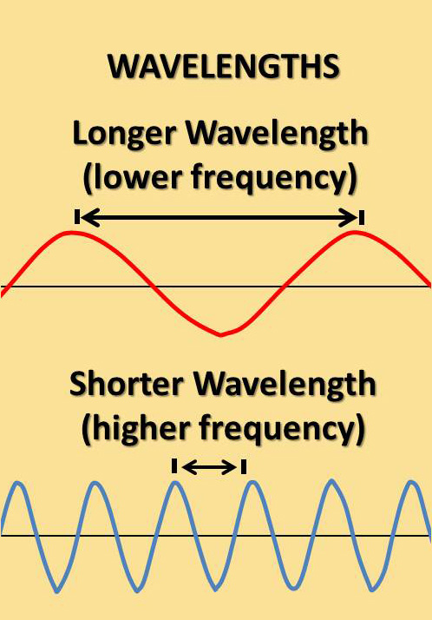
Electromagnetic Waves
Energy: The Driver of Climate
Electromagnetic waves are waves that can cause charged particles (such as electrons) to move up and down.
These waves have both electrical and magnetic properties and can travel through gases, liquids, solids, and through empty space (or a vacuum) at nearly 300,000 kilometers per second (the speed of light).
Electromagnetic waves are characterized by wavelength and frequency.
The wavelength is the distance between two wave crests or troughs. The highest point of a wave is called the crest, and the lowest point of a wave is called the trough.
Frequency is expressed in hertz (Hz) and refers to the number of wavelengths that pass a fixed point in 1 second.
The shorter the wavelength is, the higher its frequency will be. The reverse is also true.

Slide 15
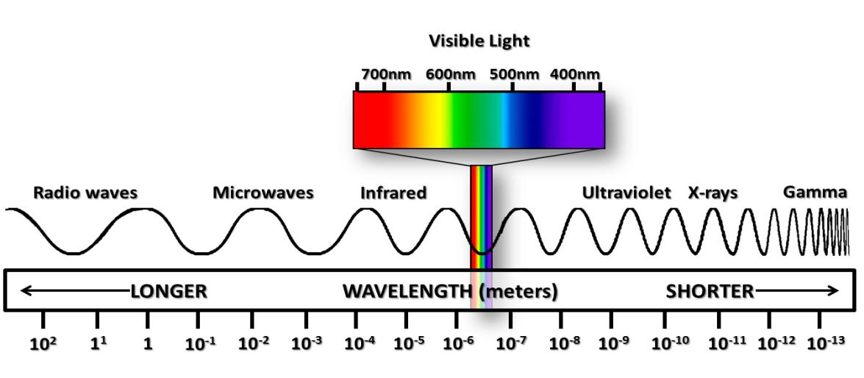
Electromagnetic Spectrum
Energy: The Driver of Climate
The electromagnetic spectrum represents the complete range of electromagnetic radiation.
The region of the spectrum with a shorter wavelength than the color violet is referred as ultraviolet radiation, and the region of the spectrum with a longer wavelength than the color red is referred to as infrared radiation.

Slide 16
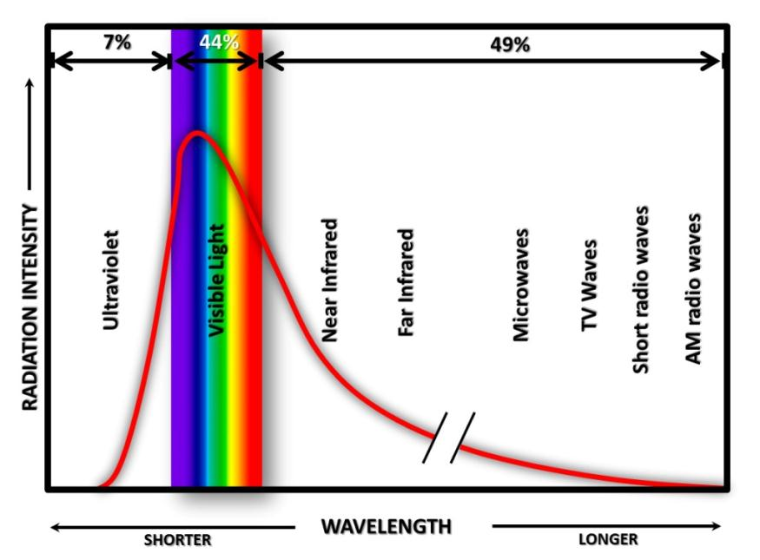
The Sun’s Electromagnetic Spectrum
Energy: The Driver of Climate
The energy that reaches the Earth is known as solar radiation.
Although the sun emits radiation at all wavelengths, approximately 44% falls within visible-light wavelengths.
The region of the spectrum referred to as visible light (light our eyes can detect) is composed of relatively short wavelengths in the range 400 nanometers (nm), or 0.4 micrometers (μm), through 700 nm, or 0.7 μm.

Slide 17
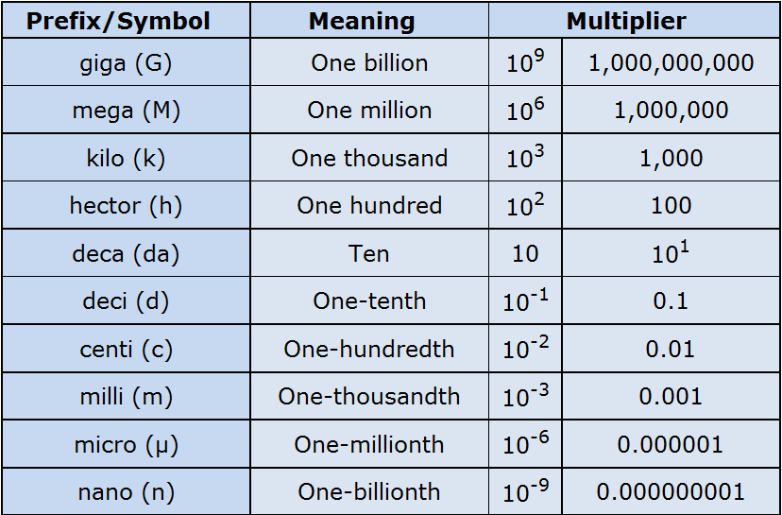
Energy: The Driver of Climate
A Review of Commonly Used Metric Units

Slide 18

The Correlation Between Temperature and Radiation
Energy: The Driver of Climate
All objects actually emit radiation if their temperature is greater than absolute zero. Absolute zero is equal to zero Kelvin, which is equal to −273°C or −460°F.
Both the sun and Earth’s surface behave as blackbodies. An object that absorbs and emits all possible radiation at 100 percent efficiency is called a blackbody.
For this reason, the Stefan-Boltzmann and Wein’s laws can be used to explain the correlation between temperature and radiation for the sun and Earth.

Slide 19
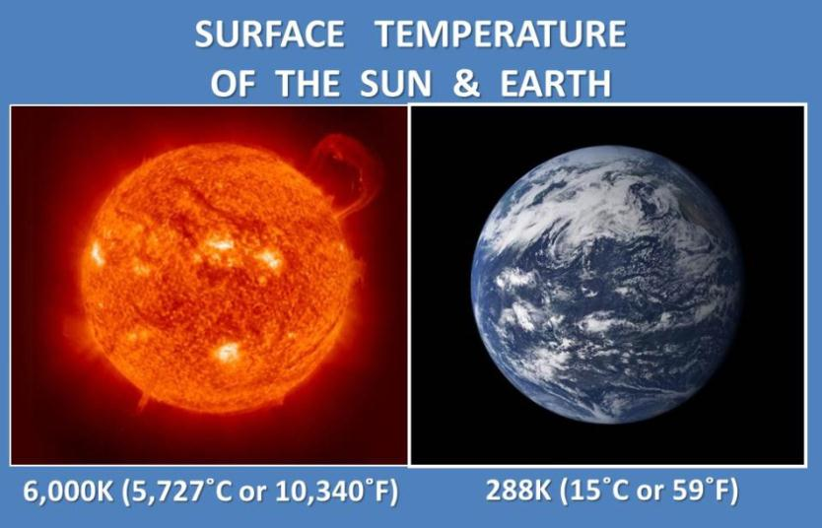
Stefan-Boltzmann Law
Energy: The Driver of Climate
The Stefan-Boltzmann law, a fundamental law of physics, explains the relationship between an object’s temperature and the amount of radiation that it emits.
This law states that all objects with temperatures above absolute zero (0K or −273°C or −460°F) emit radiation at a rate proportional to the fourth power of their absolute temperature.
E = σT⁴
E - maximum rate of radiation (often referred to as energy flux) emitted by each square meter of the object’s surface.
“σ” (sigma) - the Stefan-Boltzmann constant (5.67 x 10⁻⁸W/m²K⁴)
W (watt) - unit used to express power (expressed in joules per second).
T - object’s surface temperature in Kelvin.

Slide 20
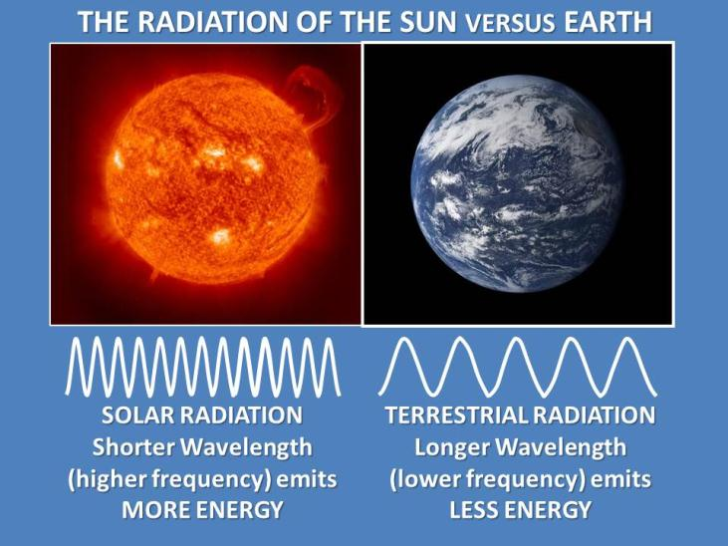
Wien’s Law
Energy: The Driver of Climate
Wien’s law, another law of physics, explains the relationship between the object’s temperature and the wavelength it emits.
Wien’s law, another law of physics, explains the relationship between the object’s temperature and the wavelength it emits.
λ_{max} = constant/T
“λ” (lambda) – wavelength at which maximum radiation is emitted
T - object’s temperature in Kelvin
Constant - 2,897 μm (micrometers).
The higher the object’s temperature, the faster the molecules will vibrate and the shorter the wavelength will be.
Wein’s law explains why the hot sun emits radiation at relatively shorter wavelengths, with the maximum emission in the visible region of the spectrum, and why the relatively cool Earth emits almost all of its energy at longer wavelengths in the infrared region of the spectrum.
For this reason, solar radiation is often referred to as shortwave radiation, and terrestrial radiation as longwave radiation.

Slide 21
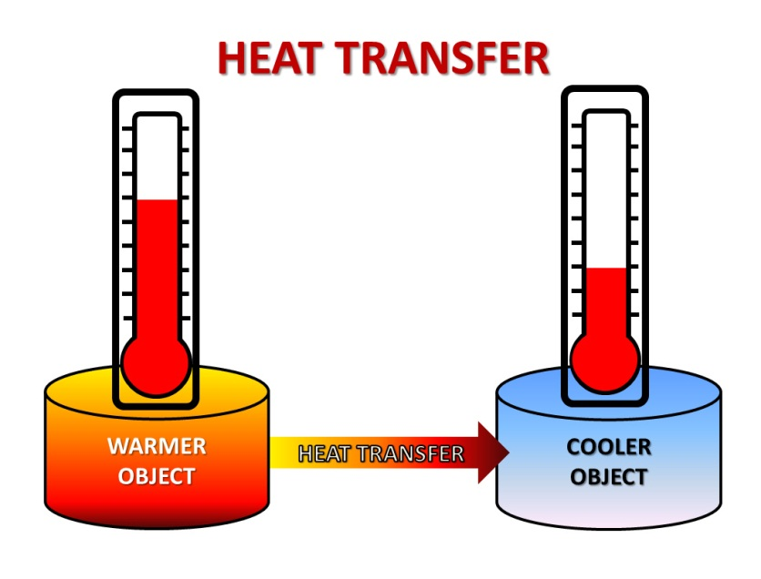
Heat Transfer in Earth’s Atmosphere
Energy: The Driver of Climate
Understanding the basic mechanism of heat transfer within Earth’s atmosphere and between its surfaces (land and water) and the atmosphere will help you learn how Earth’s energy balance works to regulate our climate.
Heat is energy in the process of being transferred from one substance (or object) to another. This process occurs when there is a temperature difference between the two substances. Heat is always transferred from a warmer object to a cooler one.
Temperature is a measurement of the average speed of the atoms and molecules that make up a substance.
When Earth absorbs the sun’s energy (most of which arrives in the form of visible light), the energy changes into heat. Some of that energy, in turn, is then radiated away from Earth’s surface.
Heat energy is also spread throughout Earth’s atmosphere through conduction and convection.

Slide 22
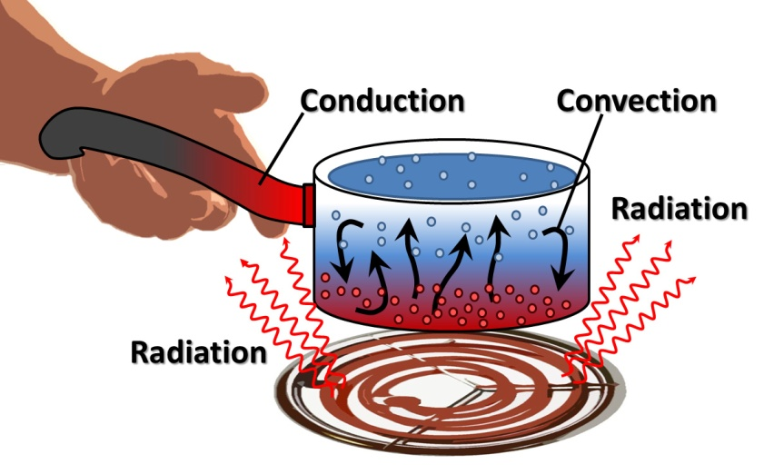
Conduction
Energy: The Driver of Climate
Conduction is the direct spread of heat from a warmer substance (in this case, land or water) to a cooler substance (the atmosphere).
The heat energy transfers when molecules collide with one another. Therefore, conduction, as a heat transfer mechanism, occurs at Earth’s surface where the air is in direct contact with the surface.

Slide 23
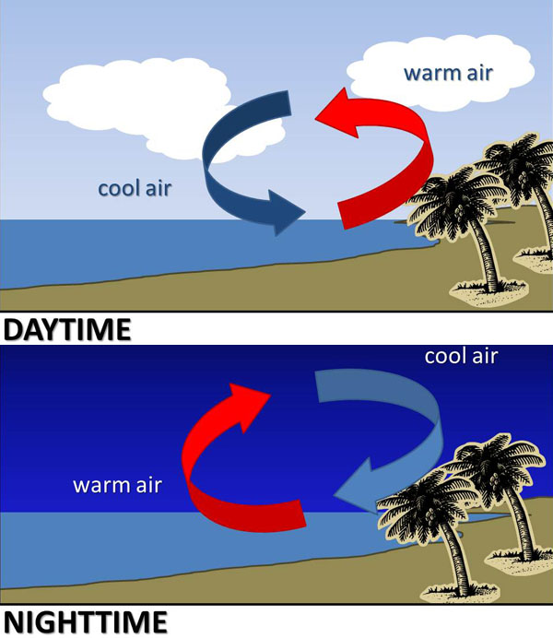
Convection
Energy: The Driver of Climate
Heat is transferred vertically in the troposphere by convection.
Convection currents form when there is unequal heating of the atmosphere or water.
As air or water warms, it expands and becomes less dense than the air or water above, and it rises. As air or water cools, its density increases and it sinks.
Conduction and convection work together to transfer heat. We can sense the resulting change in temperature, so these heat transfer mechanisms are known as sensible heating.

Slide 24
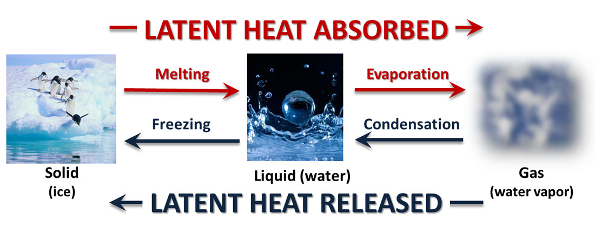
Another Type of Heat Transfer –
Latent Heat
Energy: The Driver of Climate
When water changes phase, heat is exchanged between the water and its surroundings — the water either absorbs or releases heat depending on the phase change. This type of heat is called latent heat, because that heat is stored or hidden until the phase change occurs.
Heat is absorbed when water changes from a liquid to a gas (water vapor). This energy that is absorbed gives the molecules the extra motion that is needed to escape the surface of the liquid to become a gas.
This process is known as evaporation, and the absorption of heat is called the latent heat of evaporation (or latent heat of vaporization). When the solid phase (ice) changes to a liquid, melting occurs and heat is also absorbed.
Heat is released when water changes from a gas (water vapor) to a liquid.
Cooler air cannot hold as much moisture, so the water vapor condenses. The latent or hidden heat is then released, which is why this process is known as the latent heat of condensation.

Slide 25
Earth’s Energy Balance
Energy: The Driver of Climate
The balance in the rate of Earth’s absorption and emission occurs at 255K (−18°C or 0°F), but Earth’s average temperature is actually much warmer (288K, 15°C, or 59°F).
This difference can be explained when you take into consideration the atmosphere. Even though Earth’s atmosphere absorbs and emits infrared radiation, it does not absorb and emit equally.
Certain gases in the atmosphere absorb some wavelengths of radiation (transferring their energy into heat), while other gases are transparent and allow radiation to pass through freely, without absorption taking place.

Slide 26

What Happens to Incoming Solar Radiation?
Energy: The Driver of Climate
The solar radiation Earth receives primarily consists of shorter wavelengths of visible light.
As Wein’s law explains, the sun’s high temperature emits solar radiation of mostly shorter wavelengths.
This incoming solar radiation may be scattered, reflected, or absorbed.

Slide 27
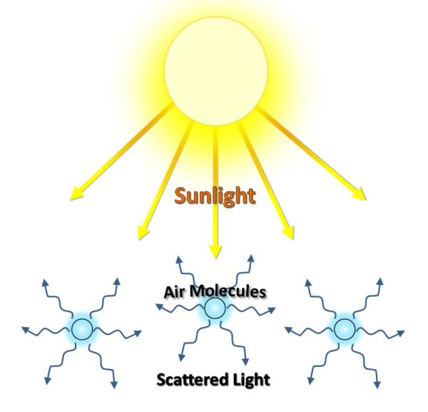
Scattering
Energy: The Driver of Climate
Scattering of solar radiation occurs when the radiation strikes very small objects in Earth’s atmosphere, such as air molecules, tiny water droplets, ice crystals, or aerosols (tiny airborne particles), which disperse the solar radiation in all directions
Air molecules are much smaller than the wavelengths of visible light striking them. Therefore more of the blue, shorter wavelengths of light are scattered than the red, longer wavelengths of light.
This is the reason why the sky appears blue during the daytime. Water droplets and ice crystals that make up clouds scatter light equally at all wavelengths and therefore appear white.

Slide 28
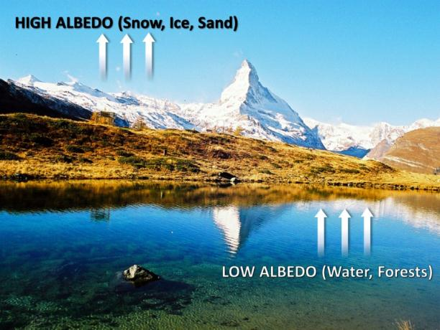
Reflection
Energy: The Driver of Climate
Reflection of solar radiation occurs when the radiation is sent directly backward from a surface.
The fraction (or percentage) of radiation reflected back is known as albedo.
Albedo varies greatly from one location to another on Earth, depending on the type of surface, the extent of snow or vegetation coverage, and the angle of the incoming solar radiation.
Glaciers and ice sheets have high albedos, reflecting 80% to 90% of the radiation reaching their surfaces.
The albedo of clouds varies depending on their thickness, with an average albedo of 55%.

Slide 29

Absorption
Energy: The Driver of Climate
Absorption is different from scattering and reflection, because absorption involves more than a change in the direction of the radiation.
Absorption of radiation involves the conversion of electromagnetic radiation into heat energy.

Slide 30
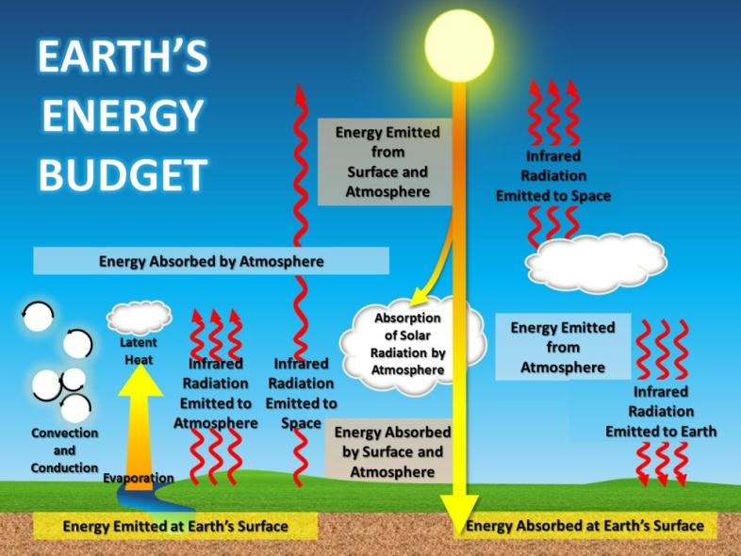
Earth’s Global Radiation Balance
Energy: The Driver of Climate
Earth’s energy balance refers to the balance between the amount of incoming solar radiation and outgoing terrestrial radiation.
The average amount of solar energy falling on one square meter of level surface outside of Earth’s atmosphere is about 342 watts.
A watt is a unit of power equal to
1 joule of energy per second, so
radiation intensity is the rate of
energy flow (joules per second)
per square meter.
This figure illustrates Earth’s incoming and outgoing radiation.

Slide 31
How Do We Calculate Earth’s Global Radiation Balance?
Energy: The Driver of Climate
This balance of incoming solar radiation and outgoing terrestrial radiation ultimately determines Earth’s global temperature and drives climate.
The energy gained and lost must balance at both
Earth’s surface and
Earth’s atmosphere.
Go to Earth’s Energy Budget: How Is the Temperature of Earth Controlled? (Investigation 3.1) to learn about the processes and calculate the balance.
This figure illustrates Earth’s incoming and outgoing radiation.

Slide 32
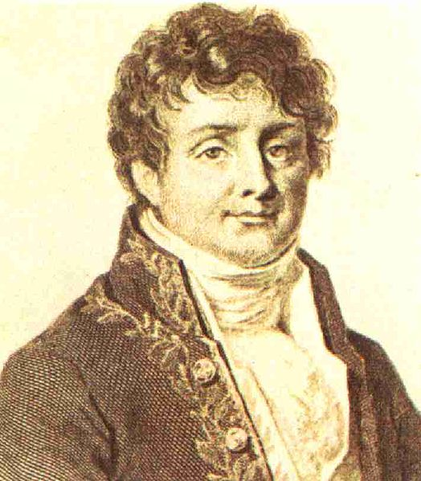
The Greenhouse Effect
Energy: The Driver of Climate
In 1827, Joseph Fourier, a French mathematician and physicist, wondered why Earth’s average temperature is approximately 15°C (59°F) when his calculations indicated that Earth should actually be much colder (−18°C (0°F).
Fourier knew that there had to be another process occurring in the atmosphere –– something similar to the way a greenhouse retains heat.

Slide 33

The Greenhouse Effect
Energy: The Driver of Climate
The name “greenhouse effect” was coined to describe Fourier’s explanation.
The atmospheric greenhouse effect has some processes in common with an actual greenhouse.
However, part of a greenhouse’s warmth results from the physical barrier of the glass, which prevents the warmer air from flowing outward.
So despite the fact that the overall mechanisms driving the greenhouse effect are different and more complex.

Slide 34
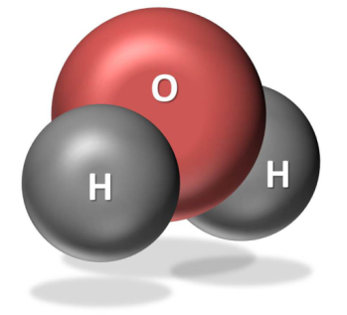
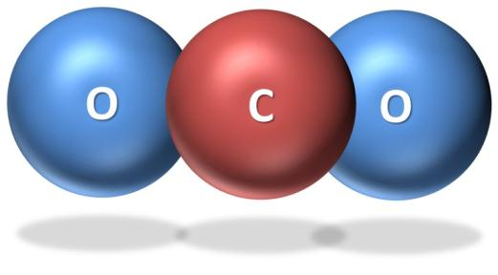
Earth's Greenhouse Gases
Energy: The Driver of Climate
Water vapor (H₂O) - the strongest greenhouse gas. The concentration of this gas is controlled by the temperature of the atmosphere.
As air becomes warmer, it can hold more moisture or water
vapor. When the air becomes saturated (or holds as much
moisture as the air can at that temperature), the excess
moisture will condense into cloud droplets. And if these
droplets are large enough, they will fall as precipitation.
Carbon dioxide (CO₂) – them most important greenhouse gas. It has a long lifetime in Earth’s atmosphere and strongly absorbs energy with a wavelength of 15 μm (micrometers). This makes carbon dioxide a good absorber of wavelengths falling in the infrared radiation region of the spectrum.
Carbon dioxide constantly moves into and out of the atmosphere through four major processes: photosynthesis, respiration, organic decomposition (or decay), and combustion or the burning of organic material. You will learn more about carbon dioxide and the carbon cycle in another module.

Slide 35
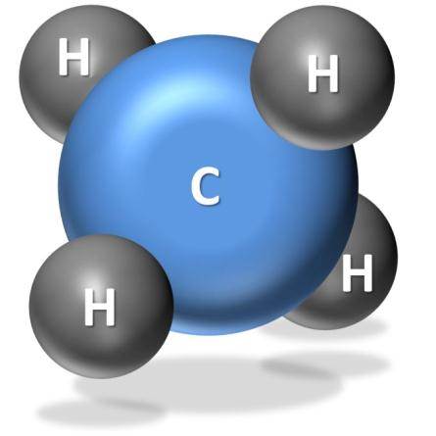
Earth's Greenhouse Gases
Energy: The Driver of Climate
Methane (CH₄) – a greenhouse gas 30 times stronger than carbon dioxide as an absorber of infrared radiation. Methane, however, is present in smaller concentrations than carbon dioxide, so its net contribution to the greenhouse effect is not as large. Methane is also relatively short-lived (lasting approximately 8 years) in the atmosphere.
Methane is produced when bacteria decompose organic plant
and animal matter in such places as wetlands (e.g., marshes,
mudflats, flooded rice fields), sewage treatment plants, landfills,
and the guts of cattle and termites. Scientists are concerned
about the concentration of methane increasing in regions where
the Arctic and alpine permafrost is thawing and releasing
methane as it warms.
Halocarbons – greenhouse gases composed of carbon, chlorine, fluorine, and hydrogen. They include chlorofluorocarbons (CFCs), which are man-made gases commonly used in refrigerators and air conditioners.
Concentrations of CFC gases in the atmosphere are the highest of any of the halocarbons, and they
can absorb more infrared radiation than any other greenhouse gas. The impact of 1 molecule of a
CFC gas is equivalent to 10,000 molecules of carbon dioxide.

Slide 36
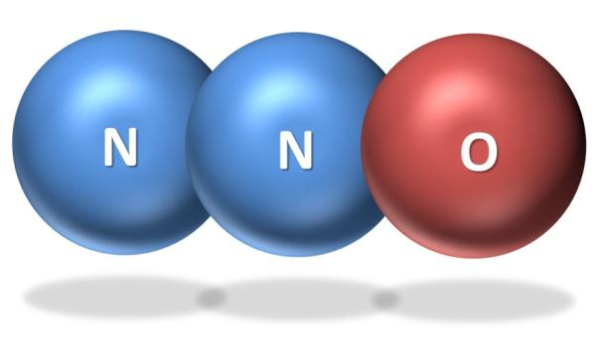
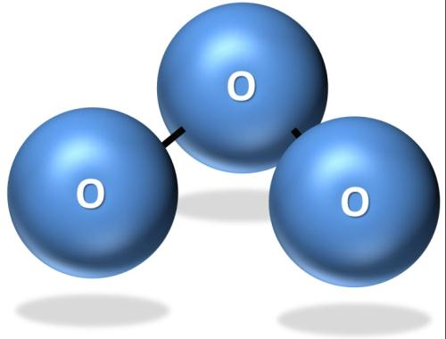
Earth's Greenhouse Gases
_{Energy: The Driver of Climate}
Nitrous oxide (N₂O) – a relatively long-lived gas, has increased in atmospheric concentration due mainly to agriculture.
Nitrate (NO₃⁻) and ammonia (NH₄⁺) are used as
fertilizers. Bacteria convert a small amount of this
nitrate and ammonia into the form of nitrous
oxide. Internal combustion engines also produce
nitrous oxide.
Ozone (O₃) - a relatively minor greenhouse gas because it is found in relatively low concentrations in the troposphere (the lowest layer of the atmosphere).
In the troposphere, ozone is produced by a combination
of pollutants — mostly hydrocarbons and nitrogen
oxide compounds.

Slide 37
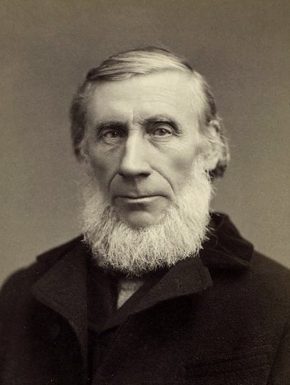
Greenhouse Gas Absorption Wavelengths
Energy: The Driver of Climate
John Tyndall was an Irish scientist who was fascinated by the growth and formation of glaciers. In the 1860s, Tyndall, wanted to test his ideas explaining how Earth maintained a fairly constant temperature.
Tyndall began a series of experiments to measure the amount of radiant heat (infrared radiation) that certain gases could absorb and transmit.
Tyndall found that water vapor and carbon dioxide were good absorbers and emitters of infrared radiation.
The relative importance of a greenhouse gas depends on its abundance in Earth’s atmosphere and how much the gas can absorb specific wavelengths of energy.

Slide 38
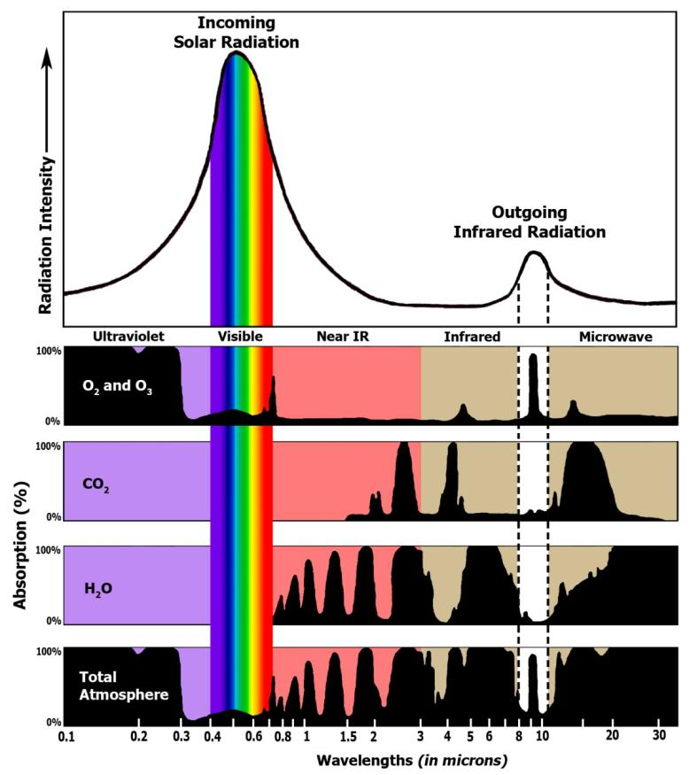
Greenhouse Gas Absorption Wavelengths
Energy: The Driver of Climate
This graphic shows the absorption bands of ozone, carbon dioxide, water vapor and total atmosphere. Gases in the atmosphere absorb energy at different wavelengths on the electromagnetic spectrum.
This graphic explains why the wavelengths in the visible light range of the electromagnetic spectrum are able to reach Earth’s surface and why the wavelengths in the infrared radiation range are emitted to space.
An effective absorber of infrared radiation has a broader absorption profile, which means that it can absorb a wider spectrum of wavelengths.

Slide 39
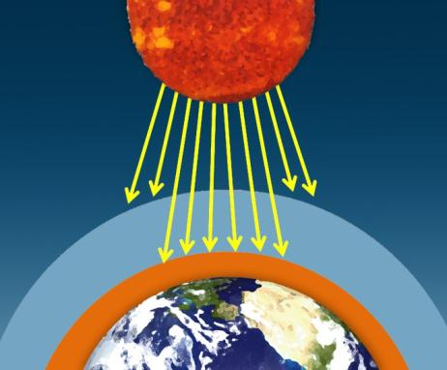
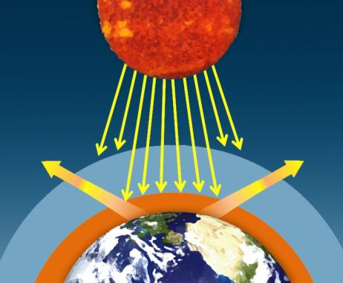
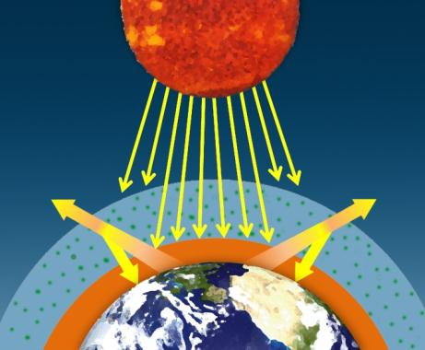
The Natural Greenhouse Effect
Energy: The Driver of Climate
The sun’s visible wavelengths of radiation pass easily through the atmosphere and reach Earth. Approximately 51% of this sunlight is absorbed at Earth’s surface by the land, water, and vegetation.
Some of this energy is emitted from the Earth’s surface back into space in the form of infrared radiation.
Much of this infrared radiation does not reach space, however, because it is absorbed by greenhouse gases in atmosphere, and is then emitted as infrared radiation back toward the Earth’s surface. This process is known as the greenhouse effect.

Slide 40
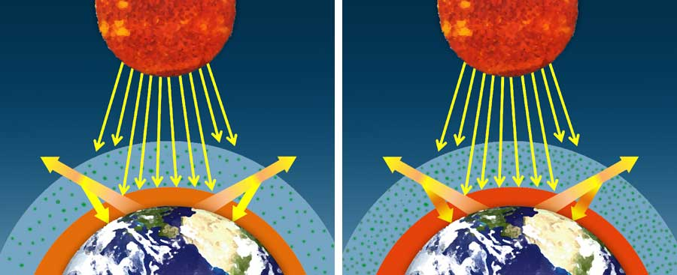
Natural Vs. Amplified Greenhouse Effect
Energy: The Driver of Climate
Certain human activities emit additional greenhouse gases to the atmosphere and increase the amount of heat that gets absorbed before escaping to space, thus enhancing the greenhouse effect and amplifying the warming of the earth.

