Slide 1
Causes of Climate Change

Slide 2
CAUSES OF CLIMATE CHANGE
Module Overview
When you complete this module, you will be able to
Explain natural causes of global climate change.
Trace the flow of carbon through the carbon cycle.
Explain the natural and human-related processes that cause increases and decreases in the concentration of greenhouse gases in the atmosphere.
Explain the trends in atmospheric carbon dioxide concentration over different time scales.
Compare the changes in atmospheric carbon dioxide and temperature over different time scales.
Explain how patterns (or fingerprints) can be used to identify the source of recent climate change.
Compare climate models of observed temperature changes due to natural causes to those that include both natural and anthropogenic (human) causes.
Describe the types of feedbacks (or processes) that amplify and reduce changes in climate.

Slide 3
CAUSES OF CLIMATE CHANGE
Radiative Forcings
The planet’s global average temperature is determined by the balance of incoming and outgoing energy from Earth.
The energy balance may be altered in three ways.
  The sun’s intensity may increase or decrease.
  The reflection of solar radiation by clouds or ice may increase or decrease, causing either more or less radiation to be reflected to space rather than to Earth’s surface.
  The amount of infrared radiation from Earth’s atmosphere to space may increase or decrease.
Any factor that causes a change to Earth’s energy balance is known as a radiative forcing or a forcing. A radiative forcing is expressed in W/m² (watts per square meter).
  A positive forcing, such as that produced by increasing concentrations of greenhouse gases, tends to warm the Earth’s surface.
  A negative forcing, such as that produced by airborne particulates that reflect solar energy, tends to cool the Earth’s surface.
Forcings may also be either natural- or human-caused (also known as anthropogenic).

Slide 4
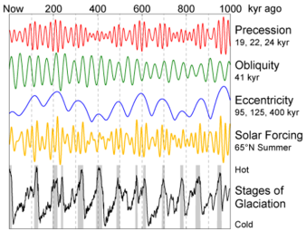
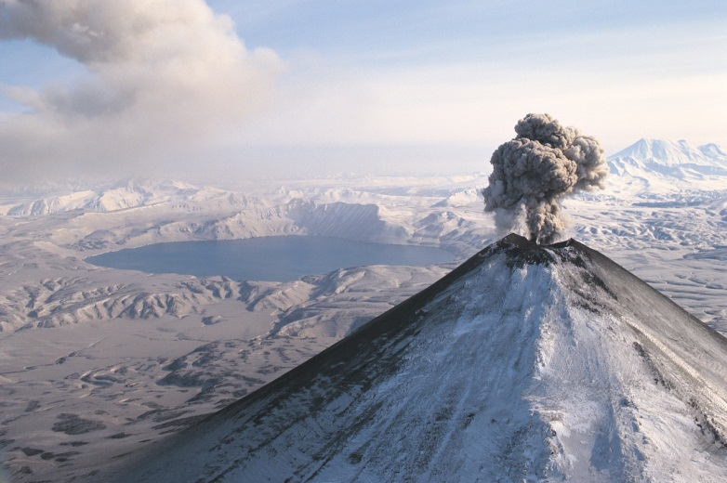
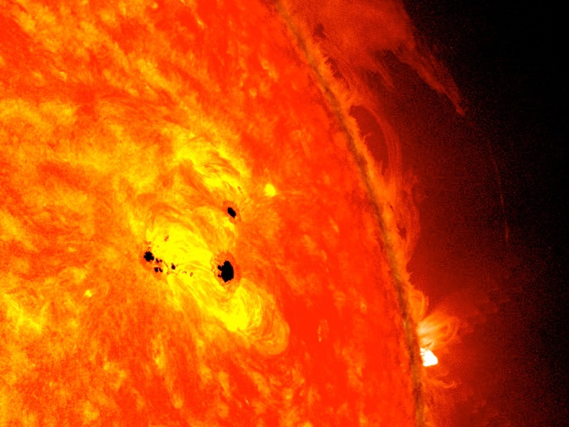
CAUSES OF CLIMATE CHANGE
Natural vs. Anthropogenic Causes
Climate has changed throughout Earth’s geologic history, mostly due to natural causes. Natural phenomena that cause shifts in global climate are
changes in Earth’s orbital cycles,
volcanic eruptions,
variations in solar activity,
movement of tectonic plates, and
the atmospheric-ocean pattern in the tropical Pacific Ocean, known as El Niño-Southern Oscillation (ENSO).
Climate also changes in response to the concentration of greenhouse gases in the atmosphere.
The concentration of atmospheric greenhouse gases can increase or decrease due to both natural phenomena and human activity.

Slide 5
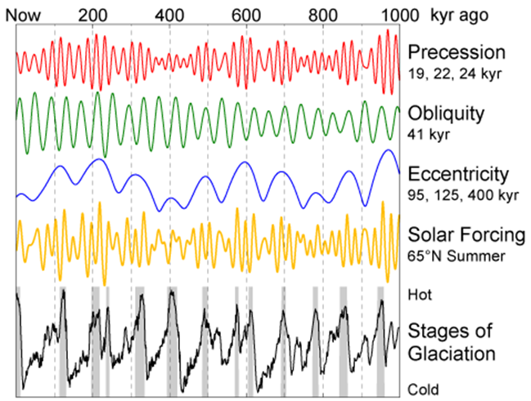
CAUSES OF CLIMATE CHANGE
Natural Causes of Climate Change - Orbital Changes
The Milankovitch Theory explains the 3 cyclical changes in Earth’s orbit and tilt that cause the climate fluctuations that occur over tens of thousands of years to hundreds of thousands of years.
These fluctuations include changes in:
the shape (eccentricity) of Earth’s orbit every ~100,000 years,
the tilt (obliquity) of Earth’s axis every ~41,000 years, and
the wobbling (precession) of Earth’s axis about ~23,000 years.
Milankovitch proposed that glacial periods began when the three cycles align to favor an extended period of more solar radiation in the winter and less solar radiation in the summer at a latitude of 65°N.
The figure above shows the alignment of each of the orbital changes to the glacial and interglacial periods. The interplay of the three orbital cycles affects the amount of solar radiation received at different latitudes over the year.
(The amount of solar radiation reaching the Northern Hemisphere at 65°N seems to control the advance and retreat of glaciers and ice sheets.)

Slide 6
CAUSES OF CLIMATE CHANGE
Natural Causes of Climate Change - Volcanoes
Volcanic eruptions discharge carbon dioxide, but they may also emit aerosols (such as volcanic ash or dust, and sulfur dioxide.)
Aerosols are liquids and solids that float around in the air. They may also include soot, dust, salt crystals, bacteria, and viruses.
Aerosols scatter incoming solar radiation, causing a slight cooling effect. They can block a percentage of sunlight and cause a cooling that may last 1-2 years.
Karymsky Volcano in Russia. Image Source: Microsoft Clip Art
Violent volcanic eruptions release ash particles and sulfur dioxide (SO₂) into the stratosphere.
The larger particles settle after a few days while the sulfur dioxide combines with water vapor to from sulfuric acid (H₂SO₄) and sulfate particles (sulfurous aerosols).
Winds transport these sulfurous aerosols around the planet in easterly or westerly directions. (For this reason, volcanoes that erupt at lower latitudes (closer to the equator) are more likely to cause hemispheric or global cooling. Volcanoes that erupt at higher latitudes (closer to the poles) are less likely to cause cooling because the sulfurous aerosols are confined to wind patterns surrounding the poles.)

Slide 7
CAUSES OF CLIMATE CHANGE
Natural Causes of Climate Change – Solar Cycles
The total amount of solar radiation varies by very small amounts. The energy emitted by the sun only varies by 1.3 W/ m². This change in solar radiation is related to the number of sunspots.
Sunspots are darker areas on the sun’s surface. A sunspot develops where an intense magnetic field weakens the flow of gases that transport heat energy from the sun’s interior. Sunspots appear dark because their temperature is lower than the surrounding area.
Sunspots. Image taken Feb. 2013 Credit: NASA/SDO/AIA/HMI/Goddard Space Flight Center
Sunspot activity increases and decreases over an approximate 11-year cycle. The sun emits slightly more radiation during active periods of sunspots.
Because the sunspots are suppressing heat, the heat flows to surrounding areas causing these regions to radiate more heat and appear brighter than normal. More sunspots are associated with a warmer global climate, and less sunspots appear to be associated with a cooler global climate. About 300 years ago, there was a period of reduced solar activity. This was called the Little Ice Age.

Slide 8
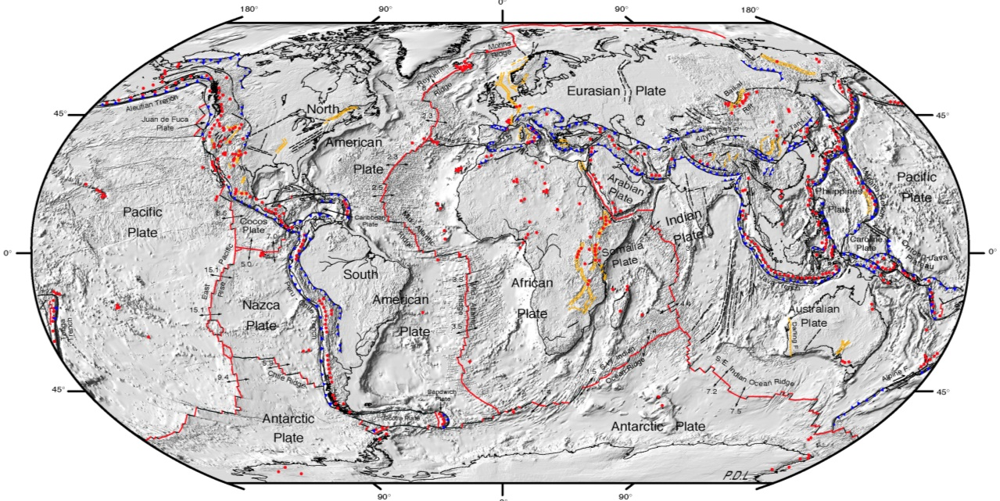
CAUSES OF CLIMATE CHANGE
Natural Causes of Climate Change – Crustal Plate Movement
As tectonic plates move over geological timescales, landmasses are carried to different positions and latitudes.
These changes affect global circulation patterns of air and ocean water and the climate of the continents.
Evidence of Plate Tectonics Affect on Climate
Coal mines were formed over millions of years ago in tropical areas, yet are found at higher and cooler latitudes today.
The Northern Hemisphere has warmed more than the Southern Hemisphere. This is because the Northern Hemisphere has a larger percentage of Earth’s landmass compared to ocean than the Southern Hemisphere.
(Remember that landmasses warm faster than oceans due to the high heat capacity of the oceans.)

Slide 9
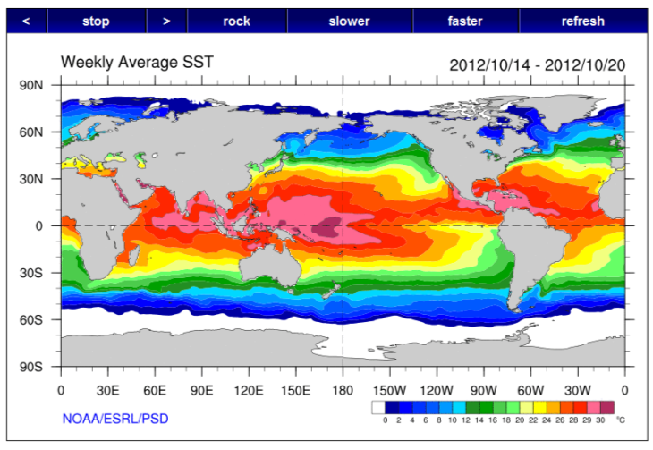
CAUSES OF CLIMATE CHANGE
Natural Causes of Climate Change – El Niño (ENSO)
El Niño-Southern Oscillation (ENSO) is an oscillation of the ocean and atmosphere system in the tropical area of the Pacific Ocean that affects global weather.
Normally the southeast trade winds blow across the tropical Pacific Ocean toward the west moving warmer surface water toward the western Pacific around Indonesia and northeastern Australia.
Every 5 to 7 years, the southeast trade winds weaken for about 8 or 9 months, allowing the warm surface water to flow eastward toward South America.
This warmer current of water typically reaches the western coast of South America near Christmas (known to the Peruvian fishermen as El Niño.
Weekly Sea Surface Temperature Totals. Image Source: NOAA
El Niño (the warm-water phase of the ENSO) causes the water temperature off of South America to be warmer and changes global weather patterns.
(South America experiences wetter than average weather, while North America experiences mild but stormier winter weather. There are fewer and less intense hurricanes in the Atlantic Ocean because the rising warmer air over the eastern Pacific Ocean causes more wind shear and hurricanes are not able to form in the Caribbean Sea.)
After an El Niño phase subsides, a colder-than-normal water phase, known as La Niña, may result.

Slide 10
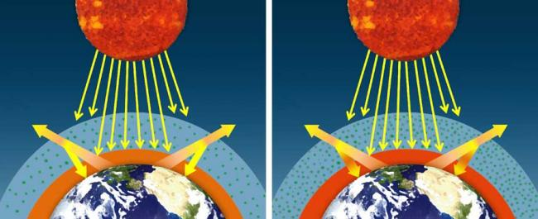
CAUSES OF CLIMATE CHANGE
Changes in Greenhouse Gases
Greenhouse gases are effective absorbers of infrared radiation and have kept Earth at approximately 15°C (59°F).
Relatively small changes in the amounts of greenhouse gases in Earth’s atmosphere can alter the balance between incoming and outgoing radiation, ultimately determining Earth’s climate.
Natural Vs. Amplified Greenhouse Effect

Slide 11
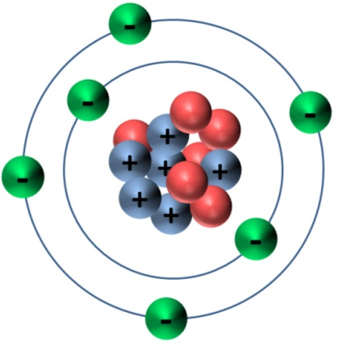
CAUSES OF CLIMATE CHANGE
The Carbon Dioxide Story
The carbon cycle explains the both the ways that carbon dioxide is produced and consumed through natural processes and the ways that humans are able to rapidly alter the cycle in very short spans of time.
Carbon dioxide (CO₂), the major greenhouse gas of concern, provides the predominant way that carbon is cycled throughout natural reservoirs.
Carbon Atom with 6 electrons, 6 protons and 6 neutrons

Slide 12

CAUSES OF CLIMATE CHANGE
Carbon
Pure carbon is very rare. It is found in nature only as the minerals, graphite and diamond.
Most carbon is bonded to other elements to form compounds. Carbon, “the building block of life,” combines with hydrogen and oxygen to form the basic compounds that make up living things. All plants and animals on earth are made of carbon, as much as 50% of our dry weight. It is the element that all organic substances contain – from fossil fuels to DNA. Hydrocarbons––such as coal, oil (also known as petroleum), and natural gas)––are compounds made of hydrogen and carbon.
Carbon is also found in calcite (CaCO₃), a mineral in limestone, a sedimentary rock, and marble, a metamorphic rock.
Carbon is found on Earth in three large reservoirs––in the atmosphere, as CO₂; in the oceans, as dissolved CO₂; and underground, as coal, oil, natural gas, and calcium carbonate rock. Carbon cycles through all four of Earth’s spheres––the atmosphere, hydrosphere, geosphere, and biosphere––on different time scales.
The cycle is known as the carbon cycle. Carbon is primarily cycled in the form of CO₂ between the natural carbon reservoirs.

Slide 13
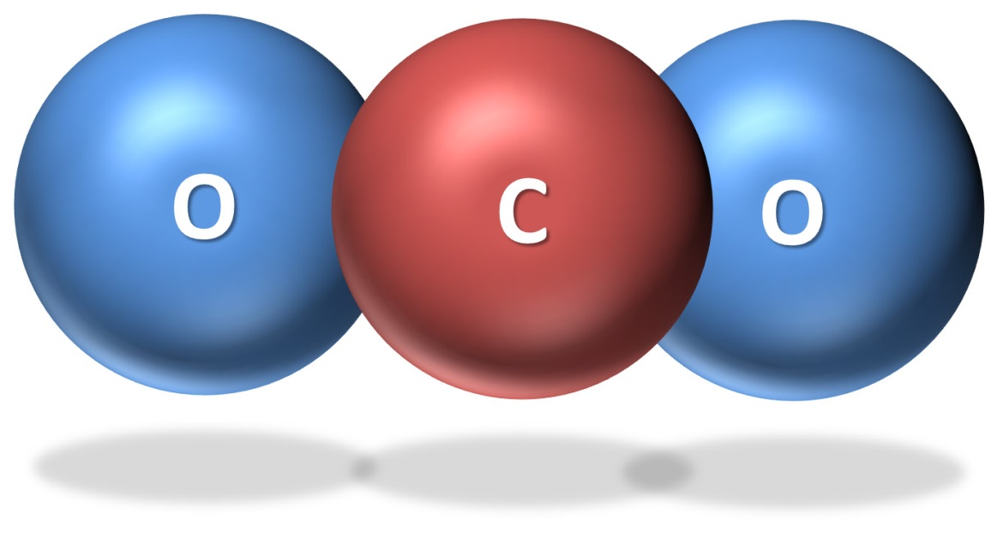
CAUSES OF CLIMATE CHANGE
The Carbon Cycle
Carbon dioxide only makes up 0.040% of the total atmosphere. However, it is the major greenhouse gas that contributes to global warming for the following two reasons.
Carbon dioxide spends a relatively long time in the atmosphere (approximately 100 years).
Carbon dioxide is also is a strong absorber of infrared radiation.
Carbon dioxide consists of one atom of carbon and two atoms of oxygen, which are held together by covalent bonds (or the sharing of electrons).
When agitated by infrared radiation, the CO₂ molecule vibrates in all three directions and absorbs heat. The molecule is then able to re-radiate or emit heat in all directions, including back toward Earth.
Thus, CO₂ absorbs infrared radiation emitted from Earth’s surface and then emits the same infrared radiation as was absorbed.

Slide 14
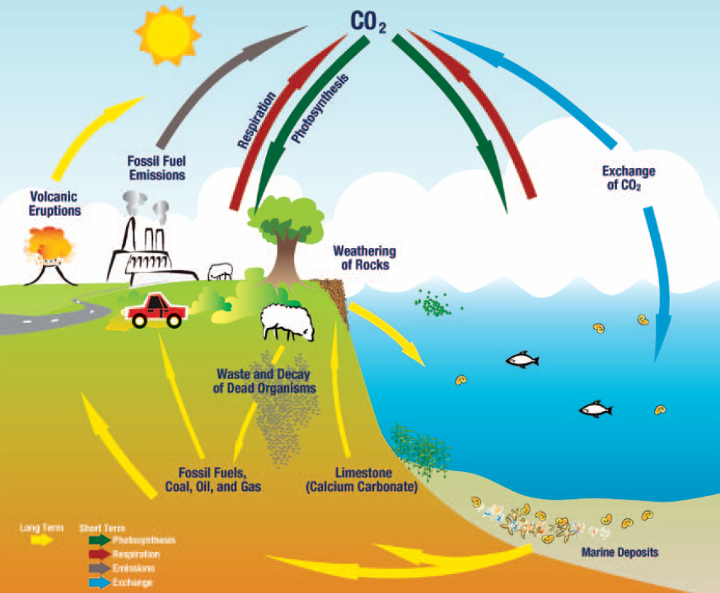
CAUSES OF CLIMATE CHANGE
The Carbon Cycle
Carbon dioxide constantly moves into and out of the atmosphere through several major pathways.
Over short time scales, the processes of photosynthesis, respiration, organic decomposition (decay), and combustion (burning of organic material) increase or decrease the concentration of atmospheric CO₂. Carbon dioxide is also exchanged between the atmosphere and oceans by gas exchange over short time scales. Each year, approximately one-fifth of the carbon (in the form of CO₂) in the atmosphere is cycled in and out.
Over longer time scales, the concentration of atmospheric CO₂ is changed by the formation of fossil fuels, weathering of rocks, and volcanic eruptions. The following sections describe these short- and long-term processes.

Slide 15
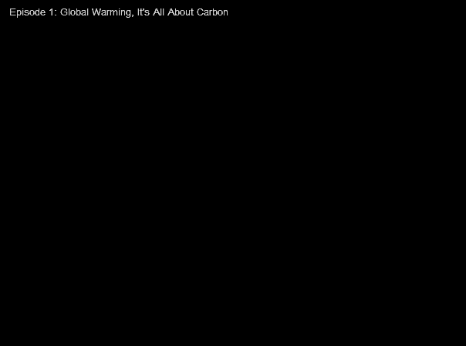
CAUSES OF CLIMATE CHANGE
Global Warming It’s All About Carbon – Episode 1
Watch Episode 1: Global Warming, It's All About Carbon.
NPR's Robert Krulwich and Odd Todd, in partnership with Wild Chronicles, present an animated cartoon series on the atom at the heart of global warming: carbon.

Slide 16

CAUSES OF CLIMATE CHANGE
Carbon Dioxide Sinks
Processes or regions that predominately absorb atmospheric carbon dioxide are referred to as sinks.
Carbon dioxide may be removed from the atmosphere when it is:
used by plants and algae for photosynthesis,
dissolved in water,
or deposited in the sediments on land or in the ocean.

Slide 17
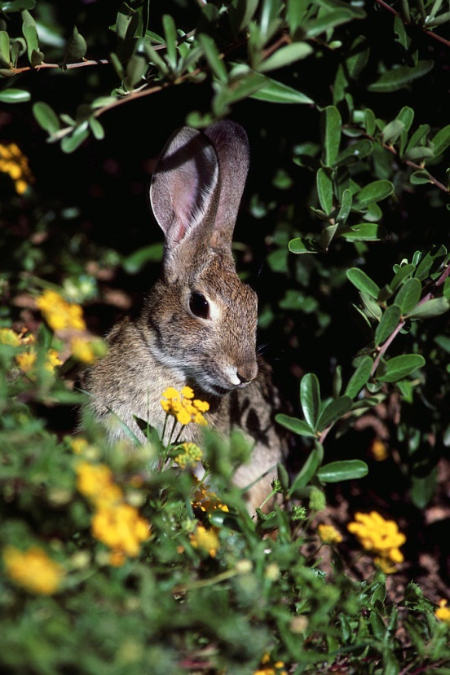
CAUSES OF CLIMATE CHANGE
Carbon Dioxide Sinks
Photosynthesis
Green plants use water from the soil and CO₂ from the atmosphere to make carbohydrates (glucose) and oxygen in the process of photosynthesis. In the ocean, algae carry on the same process.
During photosynthesis, plants and algae convert the radiant energy of the sun into chemical energy to make the carbohydrates (glucose) and produce oxygen as a byproduct. Plants and algae make more glucose in photosynthesis than they consume in respiration. The excess glucose produced by these photosynthetic organisms becomes the food consumed by animals.
6CO₂ + 6H ₂ O + energy →­­­­­ C₆ H₁₂O₆ + 6O₂
carbon dioxide + water + energy →­­­­­glucose + oxygen
Oxygen is then used by the animals and plants to oxidize food. This provides the animals and plants with energy. So when animals consume plants or they consume other animals that eat plants, they use the carbohydrates (glucose) as a source of energy.

Slide 18
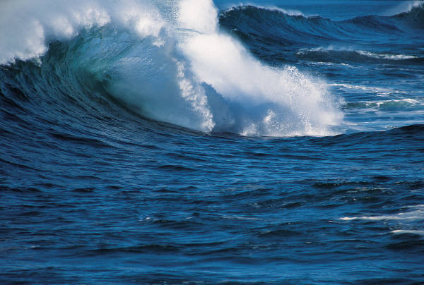
CAUSES OF CLIMATE CHANGE
Carbon Dioxide Sinks Dissolution in Water
Carbon dioxide can also be absorbed in the surface water of the ocean. As the concentration of carbon dioxide in the atmosphere increases, some of this CO₂ will be dissolved in the oceans. When the water is cooler than the atmosphere, more CO₂ can be dissolved. Gases are more soluble in cooler water than in warmer water due to the Second Law of Thermodynamics. Gases are exchanged through the ocean surface until equilibrium is reached.
When CO₂ combines with water, it forms carbonic acid.
CO₂ + H₂O →­­­­­ H₂CO₃
dissolved CO₂ + water → carbonic acid
The oceans provide a huge reservoir of carbon. Scientists estimate that the oceans hold more than 50 times the total atmospheric carbon dioxide content. However, as the ocean temperatures rise over the next centuries, surface waters will begin to release carbon dioxide and the oceans will become a source instead of a sink.

Slide 19
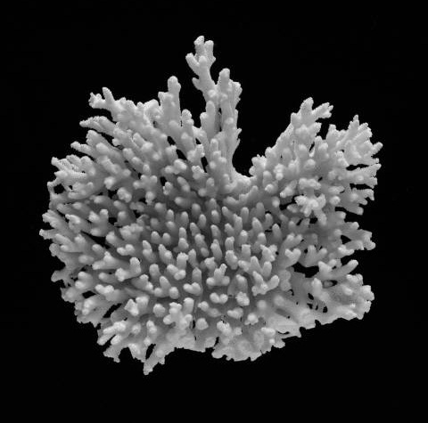
CAUSES OF CLIMATE CHANGE
Carbon Dioxide Sinks
Carbonate Sediment Deposition
Rainwater dissolves atmospheric CO₂ producing carbonic acid. Carbonic acid also reacts with rock through chemical weathering to form bicarbonate ions (HCO₃­–) that are carried by groundwater and streams to the ocean. Marine organisms use bicarbonate and the calcium (Ca²⁺) in seawater to produce the calcium carbonate (CaCO₃) that they need to make their shells, skeletons, and spines.
A coral reef is a huge colony of organisms
that use calcium carbonate to build a hard
outer skeleton.
When marine organisms die, their remains slowly sink and reach the ocean floor. Over time, these organic materials are compressed by their own weight and other sediments, gradually changing into carbonate rock, such as limestone.
Coral Skeleton – Image Source: Microsoft Clip Art

Slide 20
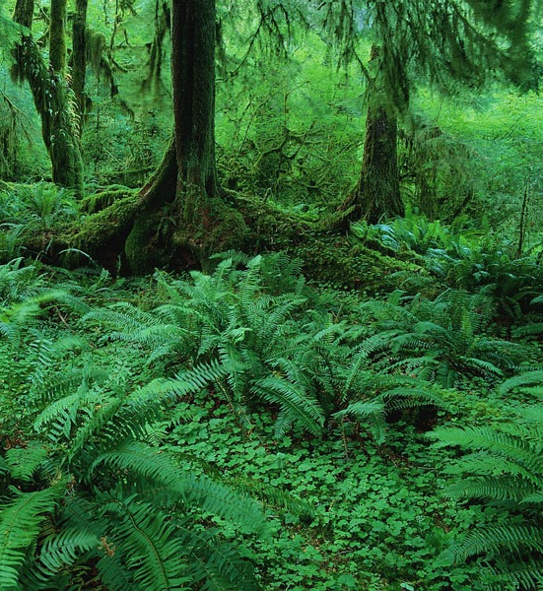
CAUSES OF CLIMATE CHANGE
Carbon Dioxide Sinks Fossil Fuel Formation
Some carbon from organic matter is deposited as sediments. This carbon-rich sediment eventually is buried and can be changed into fossil fuels (coal, oil, or natural gas) over very long periods of time. Fossil fuels formed hundreds of millions of years ago during the Carboniferous Period (about 300 million years ago) before the dinosaurs roamed the planet.
Earth was a much warmer and swampier place. When ancient marine organisms died, they decomposed and became buried under layers of mud, rock, sand, and shallow seas. Over the millions of years, these ancient plants and animals slowly decomposed and formed fossil fuels.
Coal formed from the remains of trees, ferns, and plants in swampy areas. Oil and natural gas were created from organisms that lived in rivers or shallow seas. Heat, pressure, and bacteria acted to compress and change the organic material first into oil, and later into natural gas, which formed deeper underground.
Today, we are tapping energy that was originally stored hundreds of millions of years ago.

Slide 21
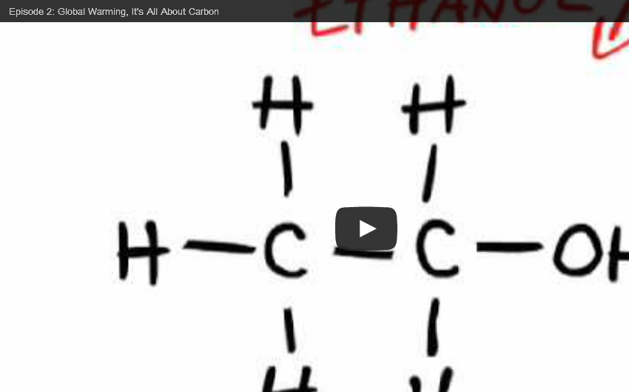
CAUSES OF CLIMATE CHANGE
Global Warming It’s All About Carbon – Episode 2
Watch Episode 2: Global Warming, It's All About Carbon.
NPR's Robert Krulwich and Odd Todd, in partnership with Wild Chronicles, present an animated cartoon series on the atom at the heart of global warming: carbon.

Slide 22
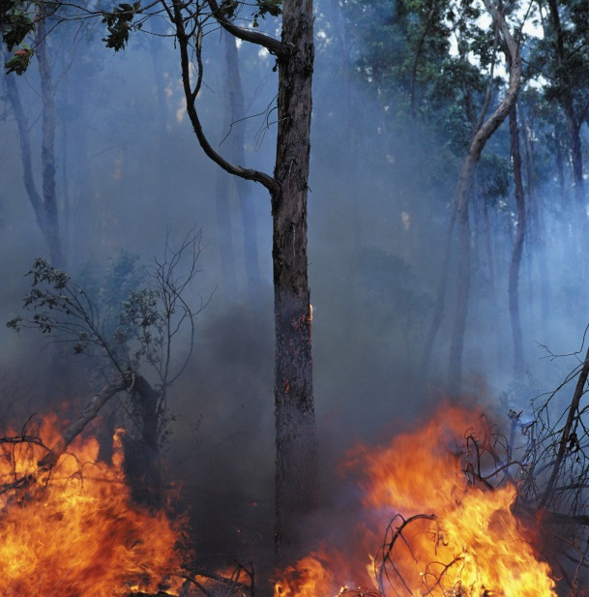
CAUSES OF CLIMATE CHANGE
Carbon Dioxide Sources
Processes or regions that predominately produce atmospheric carbon dioxide (CO₂) are referred to as sources.
Carbon dioxide is added to the atmosphere naturally when organisms respire or decompose (decay), carbonate rocks are weathered, forest fires occur, and volcanoes erupt.
Carbon dioxide is also added to the atmosphere through human activities, such as the burning of fossil fuels and forests and the production of cement.

Slide 23
CAUSES OF CLIMATE CHANGE
Carbon Dioxide Sources Respiration & Decomposition
Respiration is the exchange of oxygen and carbon dioxide between the blood of an animal and the environment. Carbon dioxide is released when organisms respire or breathe.
Respiration also takes place at the cellular level and often called cellular respiration. Every cell needs to respire to produce the energy it needs, and all plants and animals return both carbon dioxide and water vapor to the atmosphere through this process. The process of respiration produces energy for organisms by combining glucose with oxygen from the air.
During cellular respiration, glucose and oxygen are changed into energy and CO₂. Therefore, CO₂ is released into the atmosphere during the process of cellular respiration.
C₆ H₁₂O₆ + 6O₂ → 6CO ₂ + H ₂ O + energy
glucose + oxygen →­­­­­ carbon dioxide + water + energy
Respiration is also the process by which once-living (organic) organisms are decomposed. When organisms die, they are decomposed by bacteria.
Carbon dioxide is released into the atmosphere or water during the decomposition process.

Slide 24
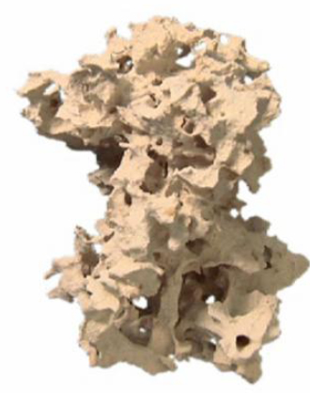
CAUSES OF CLIMATE CHANGE
Carbon Dioxide Sources
Carbonate Rock Weathering
Over geologic time, limestone may become exposed (due to tectonic processes or changes in sea level) to the atmosphere and to the weathering of rain.
The carbonic acid that forms when carbon dioxide dissolves in water, in turn, dissolves carbonate rocks and releases carbon dioxide.

Slide 25
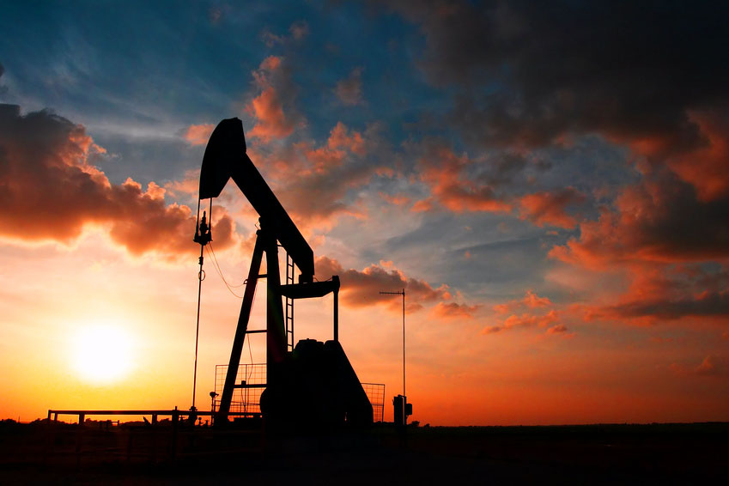
CAUSES OF CLIMATE CHANGE
Carbon Dioxide Sources
Fossil Fuel & Forest Burning
Carbon dioxide is added to the atmosphere by human activities.
When hydrocarbon fuels (i.e. wood, coal, natural gas, and oil) are burned, CO₂ is released. During combustion or burning, carbon from fossil fuels combine with oxygen in the air to form CO₂ and water vapor.
These natural hydrocarbon fuels come from once-living organisms and are made from carbon and hydrogen, which release CO₂ and water when they burn.
The burning of fossil fuels is occurring at a much higher rate than that of their production.

Slide 26

CAUSES OF CLIMATE CHANGE
Carbon Dioxide Sources Deforestation
Not only does the burning of forests release carbon dioxide, but deforestation can also affect the concentration of CO₂ in the atmosphere. Because CO₂ is used by plants for photosynthesis, fewer trees result in more CO₂ being left in the atmosphere.
Animation of Landsat satellite images showing changes in the topography due to deforestation in the Amazonian forest in Rondônia, Brazil.

Slide 27
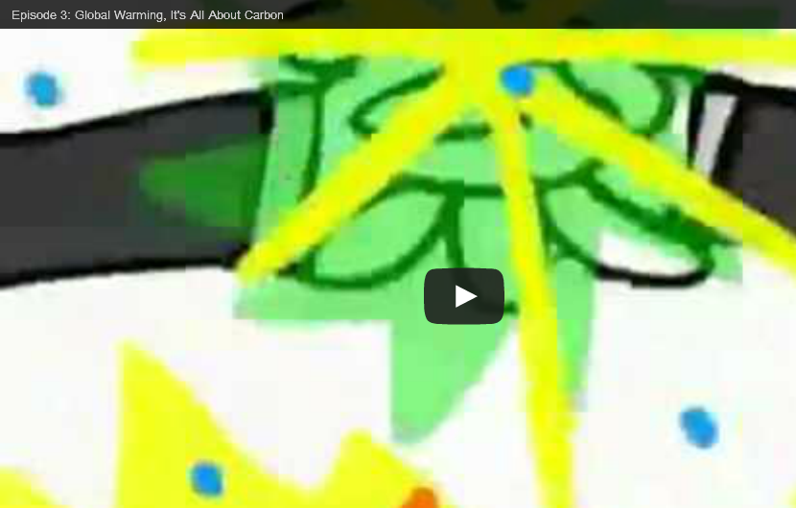
CAUSES OF CLIMATE CHANGE
Global Warming It’s All About Carbon – Episode 3
Watch Episode 2: Global Warming, It's All About Carbon.
NPR's Robert Krulwich and Odd Todd, in partnership with Wild Chronicles, present an animated cartoon series on the atom at the heart of global warming: carbon.

Slide 28
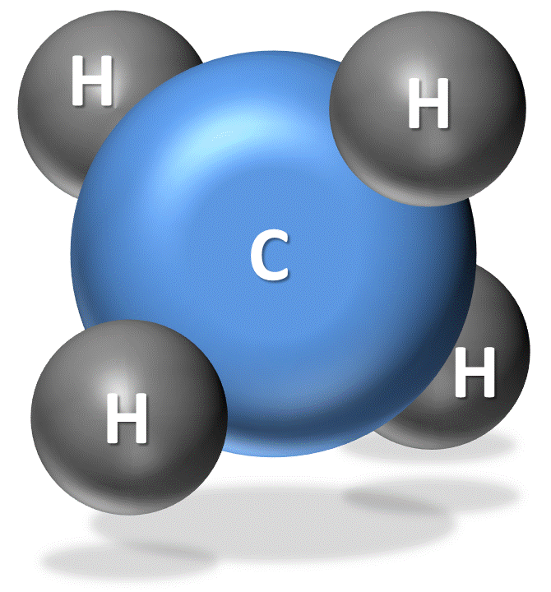
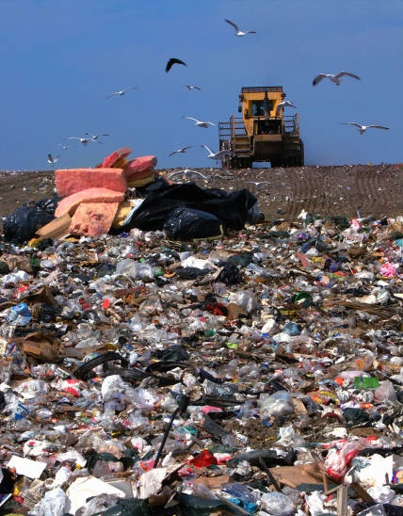
CAUSES OF CLIMATE CHANGE
Methane & The Carbon Cycle
Methane (CH₄) is also composed of one atom of carbon surrounded by four atoms of hydrogen. It is the principal component of natural gas and the second most important greenhouse gas of concern. You learned that a methane molecule is 30 times stronger than a molecule of carbon dioxide (CO₂), but methane is present in smaller concentrations and has a shorter lifetime than CO₂. Methane enters the atmosphere and eventually combines with oxygen (oxidizes) to form more CO₂. Methane converts to CO₂ by this simple chemical reaction.
CH₄ + O₂ →­­­­­ CO₂ + H₄
methane + oxygen → carbon dioxide + hydrogen
Landfills, rice farming and cattle farming release methane into Earth’s atmosphere. Methane is produced and emitted into the atmosphere when bacteria decompose organic plant and animal matter in such places at wetlands (e.g., marshes, mudflats, flooded rice fields), sewage treatment plants, landfills, and the guts of cattle and termites. Methane is also released into the atmosphere when natural gas pipelines and oil wells leak.

Slide 29
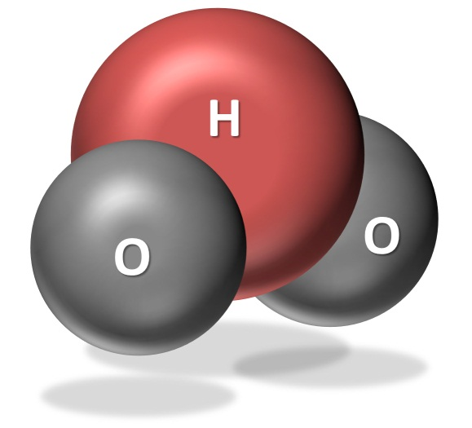
CAUSES OF CLIMATE CHANGE
Other Greenhouse Gases
Other greenhouse gases include water vapor, halocarbons, nitrous oxides, and ozone. Water vapor is the strongest greenhouse gas. The amount of water vapor (H₂O) in the atmosphere is largely controlled by the temperature of the air and therefore varies from region to region. Warmer air can hold more moisture or water vapor. When the air becomes saturated (or holds as much water vapor as the air can at that temperature), the excess water vapor will condense into cloud droplets. If these droplets are large enough, they will fall as precipitation.
Water vapor plays an important role in the climate system. As air warms, it can hold more water vapor. In turn, more water vapor can absorb and re-emit more infrared radiation. Any process that acts to amplify (positive feedback) or lessen (negative feedback) the initial cause of the change in climate is known as a climate feedback. The water vapor feedback is known as a positive climate feedback because increased amounts of water vapor amplify the warming trend.

Slide 30
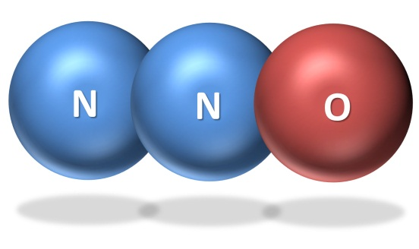
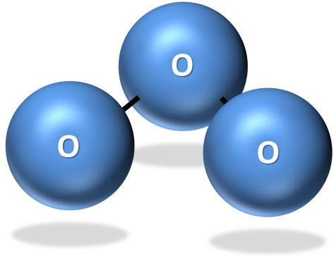
CAUSES OF CLIMATE CHANGE
Other Greenhouse Gases
Halocarbons, which are composed of carbon, chlorine, fluorine, and hydrogen, include chlorofluorocarbons (CFCs). CFCs are synthetic gases that were used in cleaning solvents, refrigerants, and plastic foam.
Nitrous oxide (N₂O), a relatively long-lived gas, has increased in atmospheric concentration due mainly to agriculture. Nitrate (NO₃⁻) and ammonia (NH₄⁺) are used as fertilizers. Bacteria convert a small amount of this nitrate and ammonia into the form of nitrous oxide. Internal combustion engines also produce nitrous oxide.
Ozone (O₃) is also a relatively minor greenhouse gas because it is found in relatively low concentrations in the troposphere (the lowest layer of the atmosphere). In the troposphere, it is produced by a combination of pollutants

