Slide 1
Aquatic Invertebrates in the Kissimmee River

Slide 2
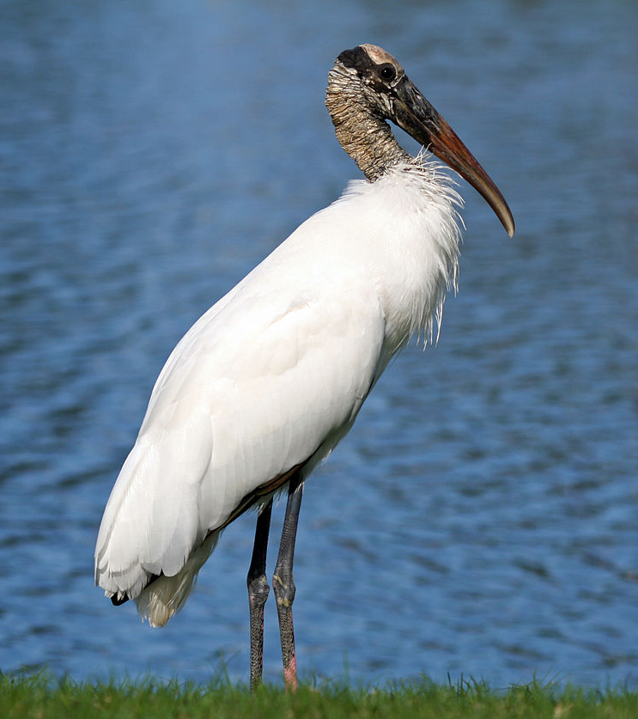
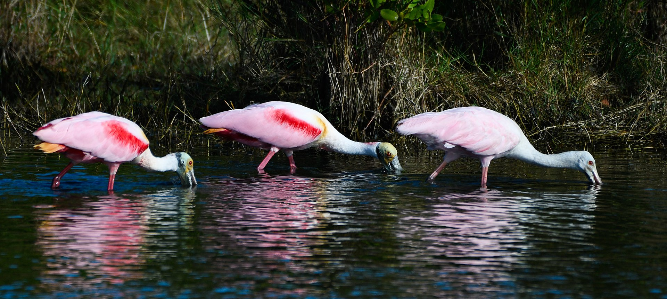
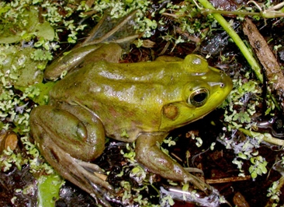
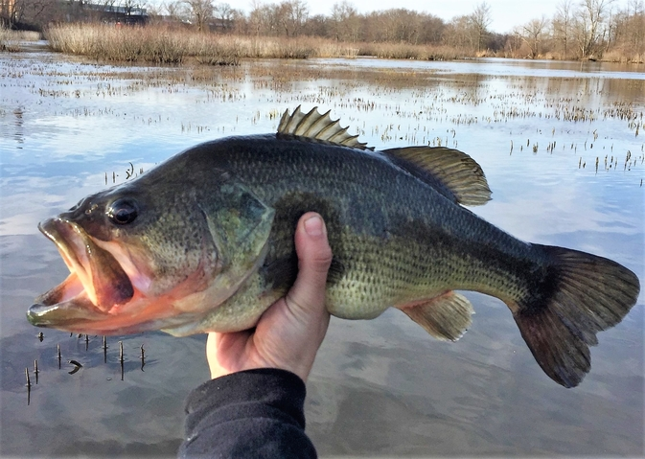
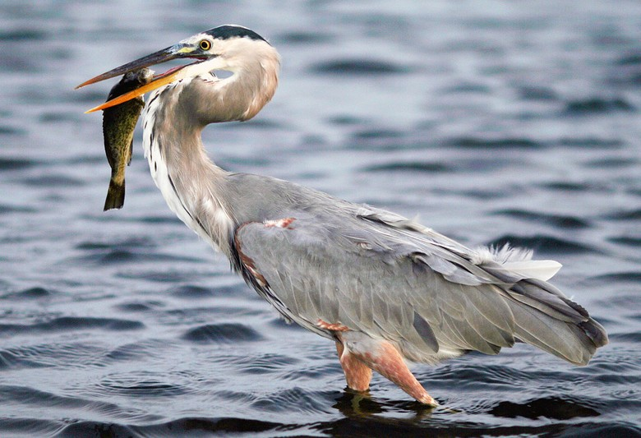
Wildlife on the Historic Kissimmee
Pig frog
Wood Stork
Roseate Spoonbills
Large mouth Bass
Great Blue Heron
Notes:
The Kissimmee River is a popular recreational destination for boating, fishing and hunting. Prior to the channelization in the 1960’s, users could easily view the beautiful birds and the abundance of fish and reptiles. However, the aquatic invertebrates, being low on the food chain and not easily visible, were probably not often examined.

Slide 3
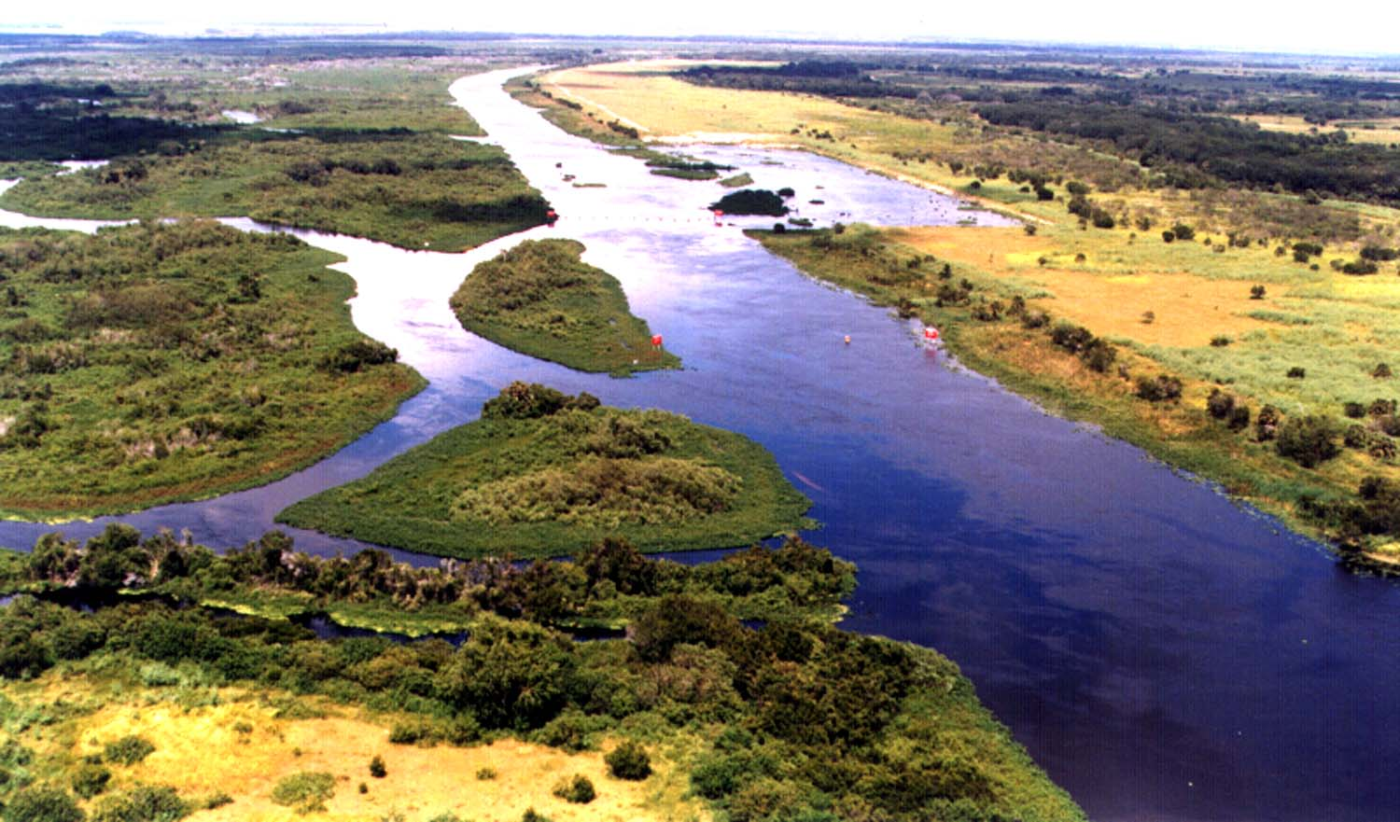
Changes after Channelization
Notes:
Following the channelization, the interruption of the natural interactions between the land and the water on the Kissimmee River ecosystem became apparent. Plants that grew along the shallow, meandering banks could not survive in the shoreless, steep banks of the C-38 canal. As the base of the wetland food chain changed, the types of primary consumers and invertebrates that lived by consuming these plants, also changed.

Slide 4
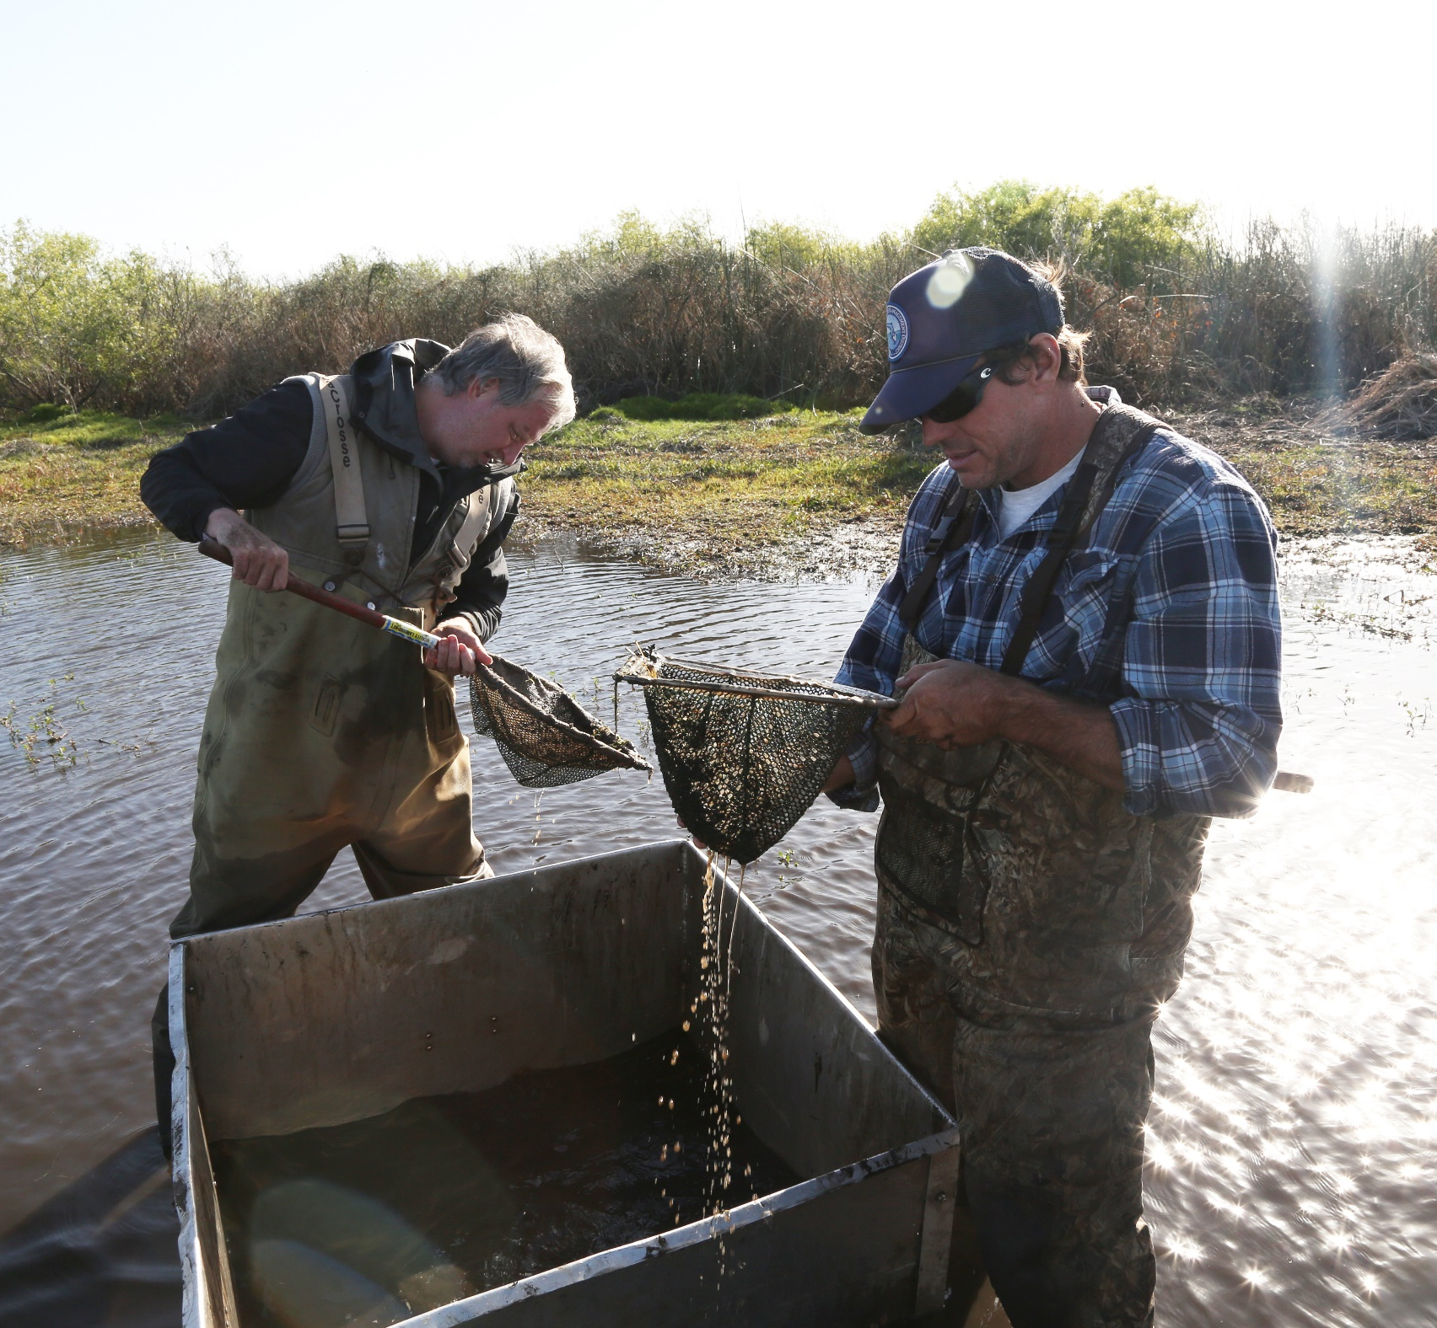
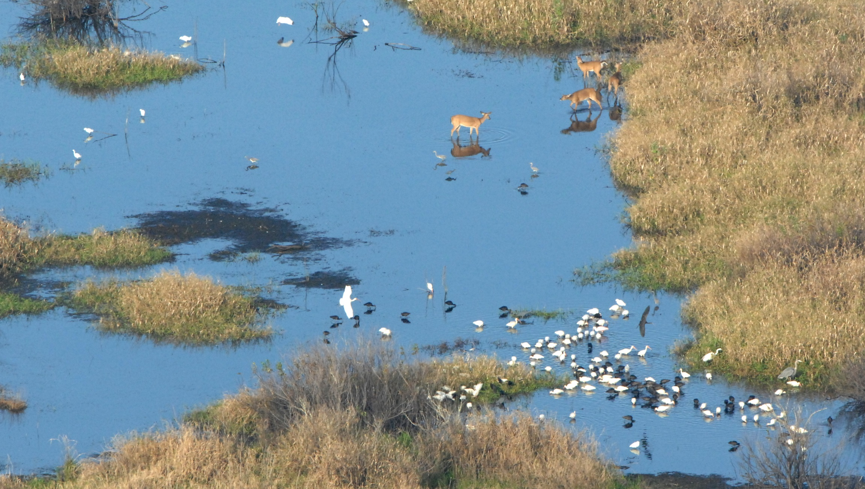
The Return of Aquatic Invertebrates
Notes:
Shortly after the restoration began, scientists started documenting changes and the return of the native aquatic invertebrate community. Once this important food source (prey) began to thrive, then the consumers such as fish and birds began to return to the restored river habitats.

Slide 5
Functional Feeding Groups
The 6 main groups are:
Shredders
Grazers/scrapers
Gathering collectors
Filtering collectors
Herbivore piercers
Predators
Notes:
To categorize invertebrates, scientists often use a system called Functional Feeding Groups. This illustrates the invertebrates’ method of feeding and types of food. Depending on their life stage and specific species, each aquatic invertebrate can represent multiple functional feeding groups. Below are the 6 main functional feeding groups and some examples for each group.
The six main groups include:
Shredders
Grazers/scrapers
Gathering collectors
Filtering collectors

Slide 6
Shredders
North American Benthological Society
Feed on organic matter such as leaf or wood litter by shredding, chewing then digesting
Example: amphipod (aka scud)

Slide 7
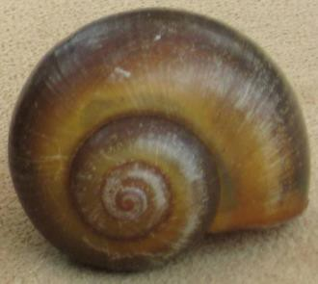
Grazers/scrapers
Feed on algae on rocks and plants
Example: apple snails

Slide 8
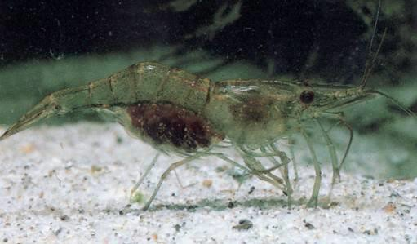
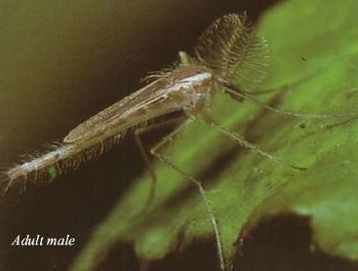
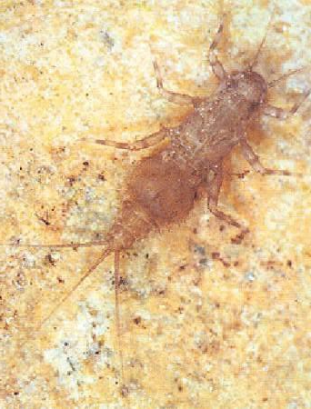
Gathering collectors
Feed by roaming and collecting deposits of organic matter from rocks
Examples: grass shrimp, crayfish, non-biting midges and mayfly larvae
Grass shrimp
mayfly larvae
midge
Carlos L. de la Rosa (3)

Slide 9
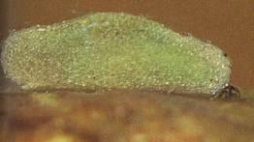
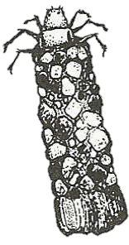
Filtering collectors
Feed by using a “net” to catch small invertebrates floating downstream
Example: caddisfly larvae
Lives in a stick or stone houses
Carlos L. de la Rosa (3)

Slide 10
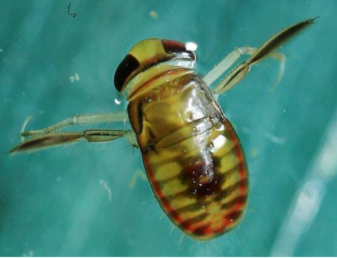
Herbivore piercers
Feed by grinding or piercing plant cells
Example: water boatman

Slide 11
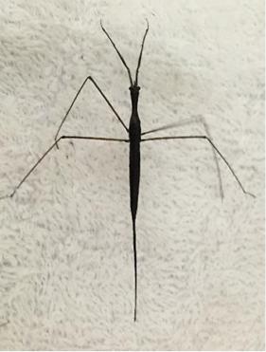
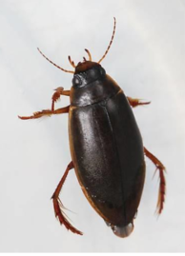
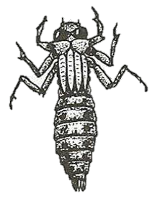
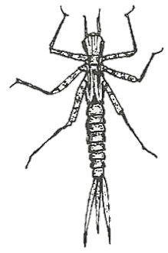
Predators
Predaceous diving beetle
Feed by eating primary consumers, such as tadpoles, mosquitoes and other insect larvae
Example: dragonflies, water scorpions, predaceous diving beetles, and damselflies
Nymph stage
Water scorpion
Dragonfly nymph
Damselfly nymph

Slide 12
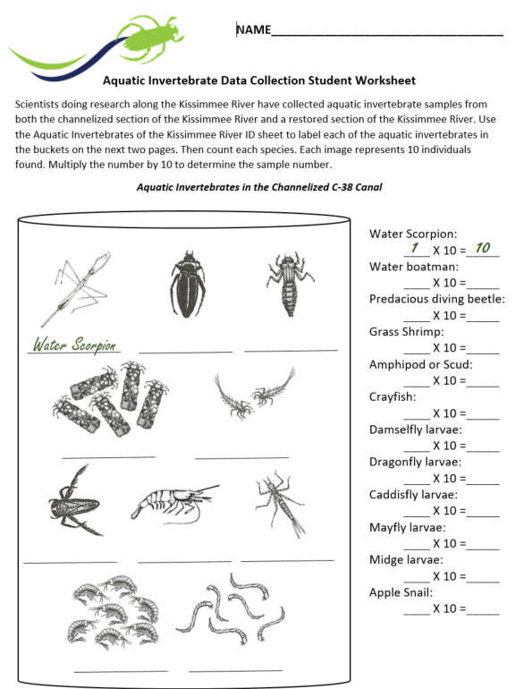
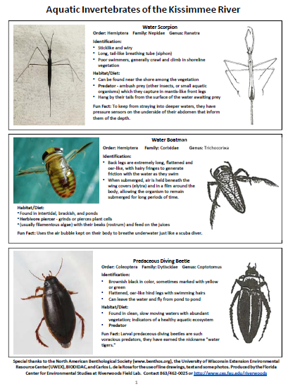
Let’s Look at the Data!
Get into your groups
Work as a team to complete the worksheet and graph the data

Slide 13
