Slide 1
Bird Populations along the Kissimmee River

Slide 2
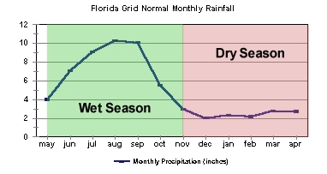
Florida’s Two Seasons
Wet Season:
May through November
25-30 inches of rain
Dry Season:
December through April
< 4 inches
Image Source: National Weather Service
Notes:
When we think about seasons, we often think of winter, spring, summer and fall. However, Florida is unique in that it just has two seasons: a wet season from May to November, which can produce an average of 25 – 30 inches of precipitation, and a dry season from December to April, which usually produces less than 4 inches during that period.
Image Source: https://www.weather.gov/mlb/enso_florida_climate_forecast

Slide 3
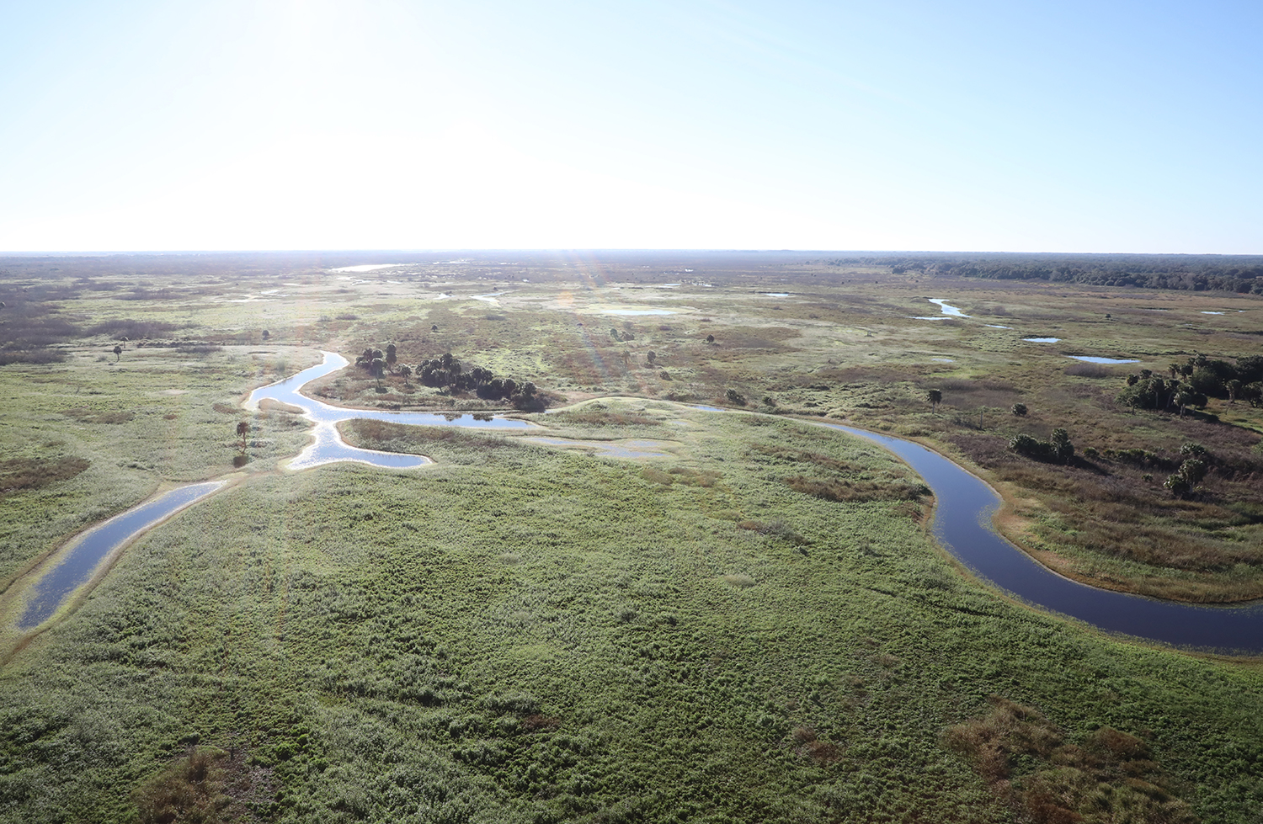
Kissimmee River Floodplain
~1 to 2 miles wide
Inundated with water for most of the year
Habitat for wading birds
Image Source: Brent Anderson
Notes:
Historically along the Kissimmee River, wet season rains would cause the river to overflow into a vast floodplain that was approximately 1-2 miles wide. The floodplain would have been inundated with water for most of the year, providing habitat for many species of wading birds, such as herons, ibises, snowy egrets, roseate spoonbills, and woodstorks.

Slide 4
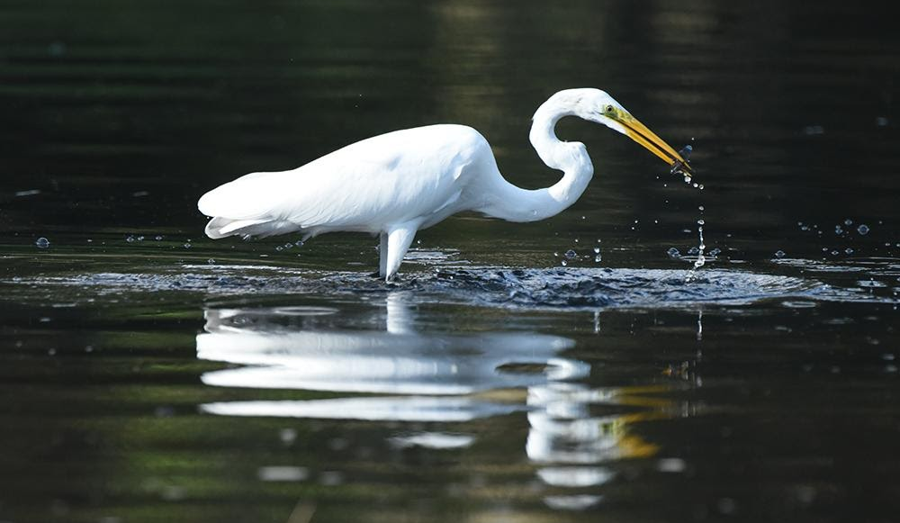
Wading Birds
Great egret
Wade in shallow waters, foraging for aquatic invertebrates and fish
Image Source: Brent Anderson
Notes:
Just as their name implies, wading birds wade in shallow waters, foraging for aquatic invertebrates and fish.

Slide 5
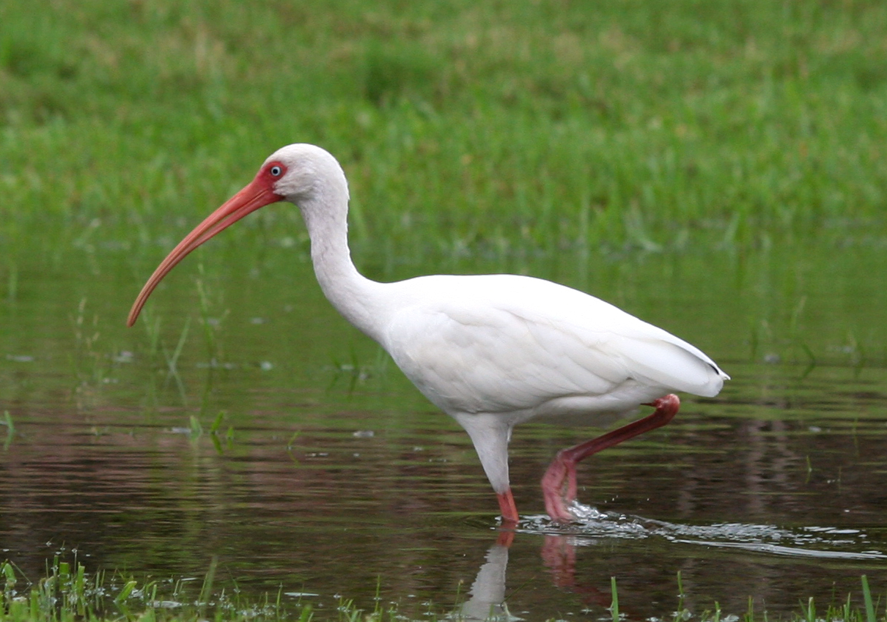
Wading Birds
Food Supply in the Dry Season:
invertebrates and fish migrate to small pools of water as the water level drops
makes food much easier to locate and carry back to their nests
White Ibis
Image Source: Wikipedia
Notes:
During the dry season, invertebrates and fish migrate to small pools of water as the water level drops. This makes food much easier to locate and carry back to their nests.

Slide 6
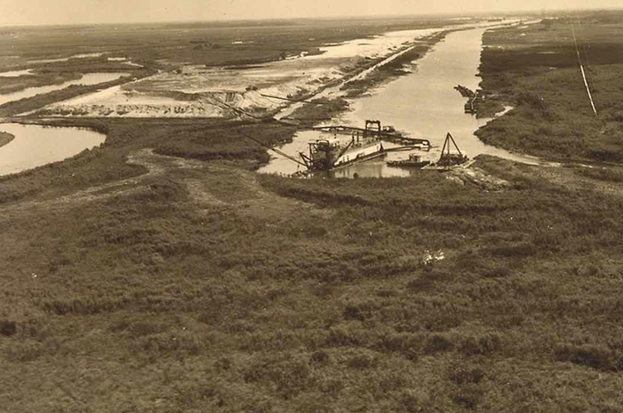
Channelization Impacts
Bird populations declined by up to 90%
Image Source: SFWMD
Notes:
When the river was channelized and the floodplains were drained, one of the most obvious indicators that the ecosystem had been negatively impacted was the change in the various bird populations. It was estimated that the bird population declined by up to 90%.

Slide 7
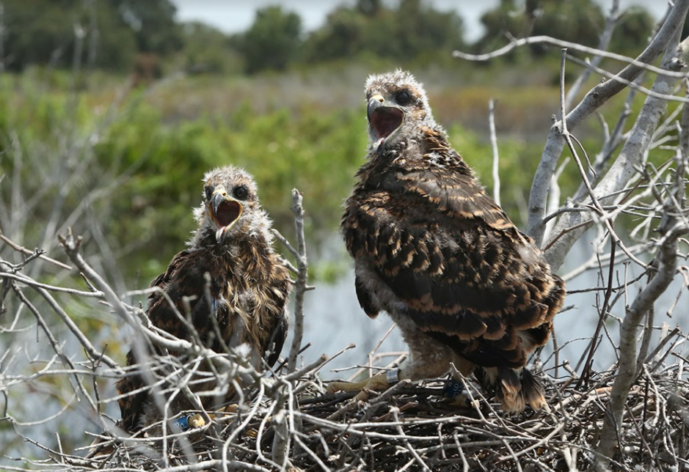
Channelization Impacts
Baby Snail Kites
Wading birds impacted
Rely on dry season for nesting and feeding young
Image Source: Brent Anderson
Notes:
Wading birds were drastically impacted because they rely on the dry season for nesting and feeding their young.
Ask students: Why do you think wading birds are better able to feed their young in the dry season?
Answer: Because when it is dryer, water levels go down and fish are concentrated into smaller areas making them easy prey!

Slide 8
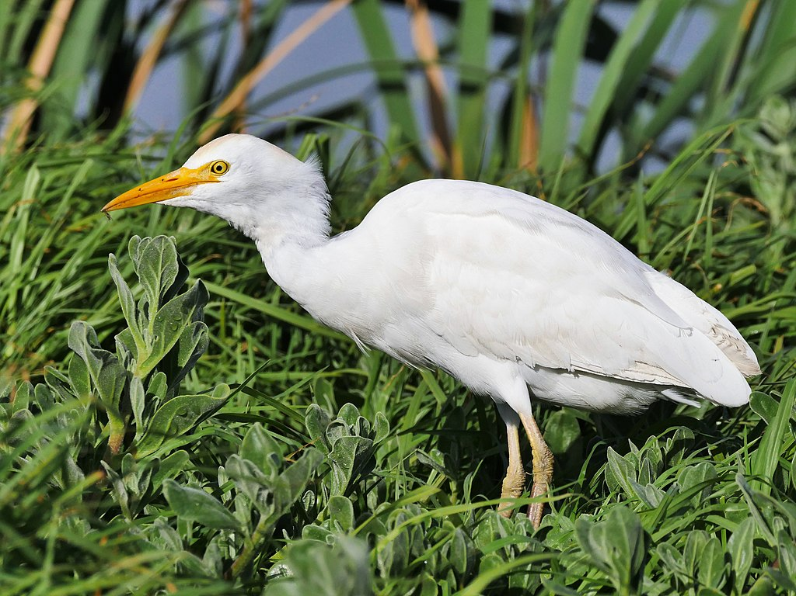
Channelization Impacts
Cattle Egret
Cattle could graze year-round
Cattle egrets expanded their range to former floodplain areas
Image Source: Wikipedia
Notes:
The now-dry floodplains allowed cattle to graze on dry land year-round. This afforded upland birds, like cattle egrets, the ability to move in thus greatly increasing their population in the former floodplain areas.

Slide 9
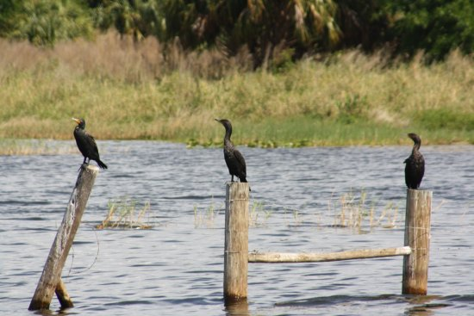
Channelization Impacts
Double-crested Cormorants on the C-38 Canal
Difficult for waterfowl to feed in the canal due to:
Increased flow
Depth (30 feet deep)
Image Source: Wikipedia
Notes:
Waterfowl, such as ducks, geese, anhingas, and cormorants can live on deeper waters. However, the increased flow and the depth of the dredged out 30-foot deep canal made feeding for them more difficult.

Slide 10
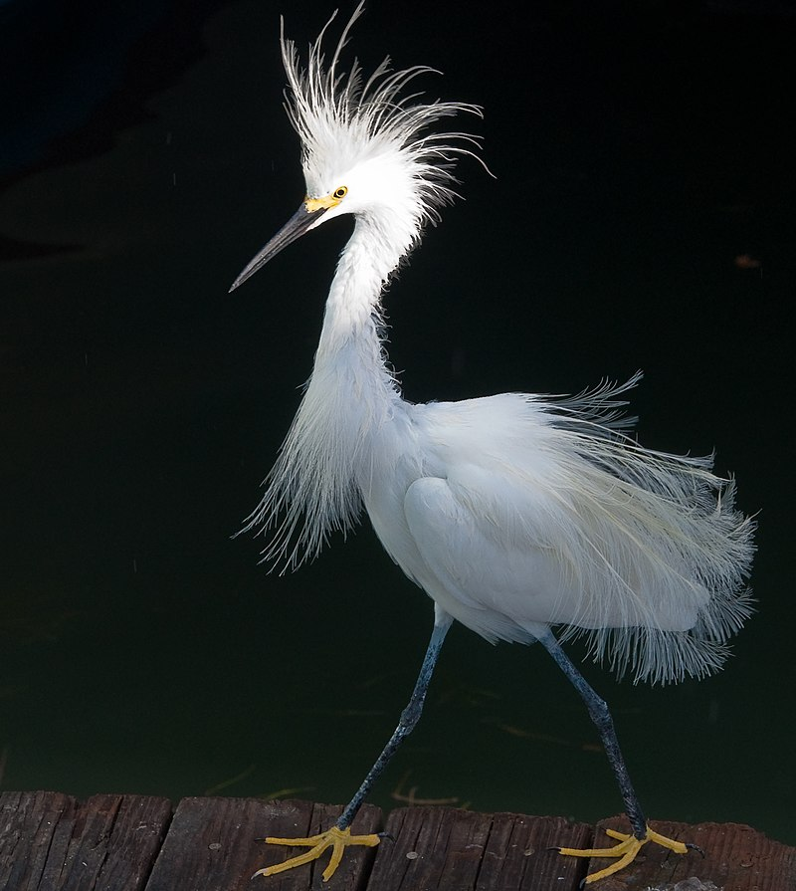
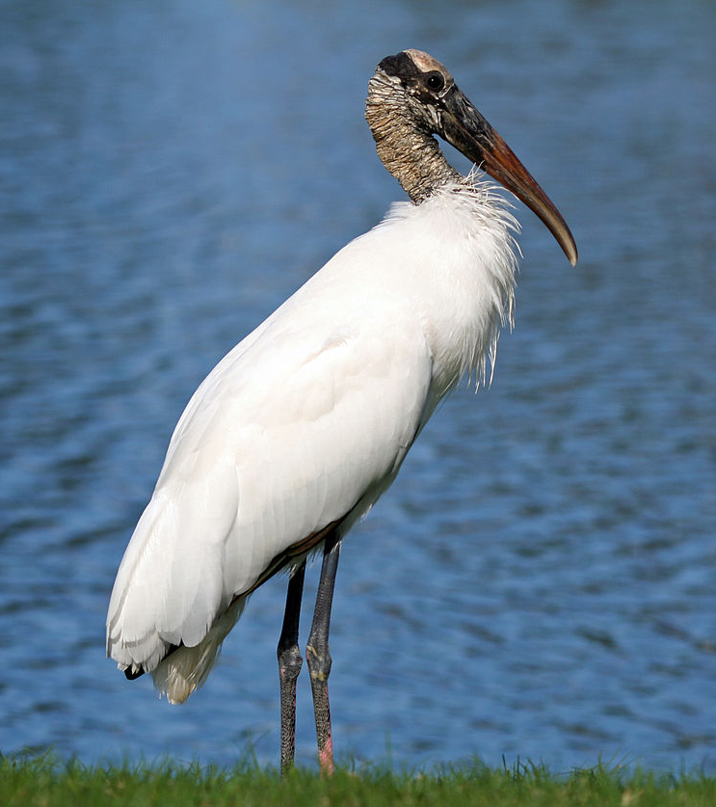
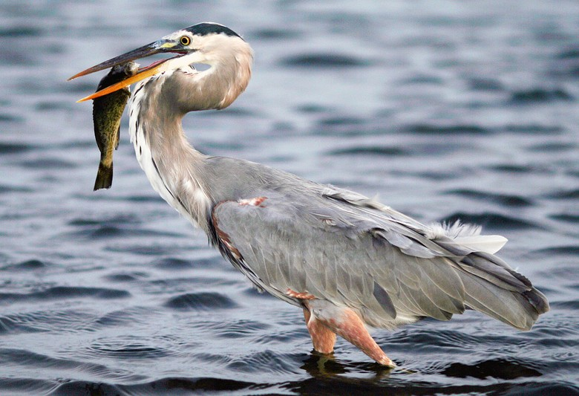
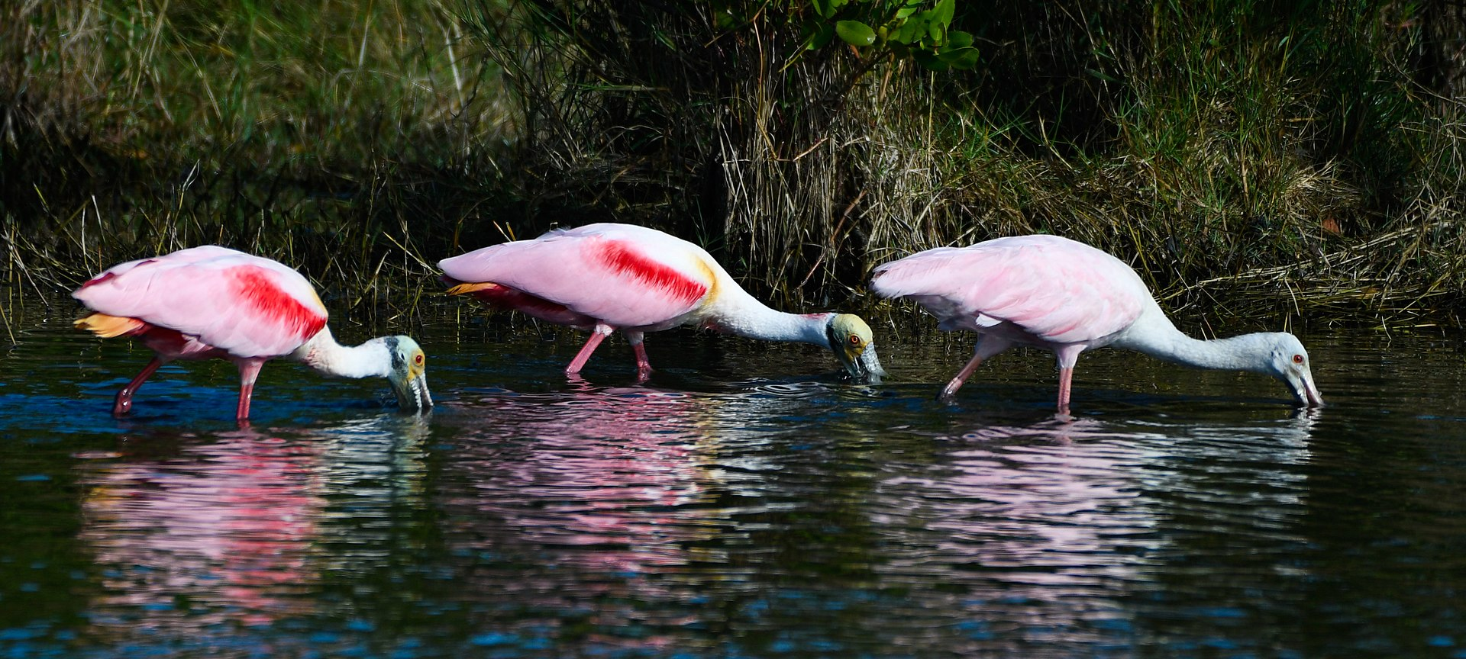
Restoration Impacts on Birds
Cattle Egret
Snowy Egret
Wood Stork
White Ibis
Great Blue Heron
Source of Images: Wikipedia
Roseate Spoonbills
Notes:
Almost immediately after the restoration project began, scientists who were monitoring bird populations noted an encouraging increase in the wading bird and waterfowl populations, while also recording a decrease in cattle egret populations. By allowing the floodplain to once again be inundated with water during the wet season, the wetland plant habitats returned, allowing aquatic invertebrates and fish to increase their populations, and enriching the food supply for wading birds.

Slide 11
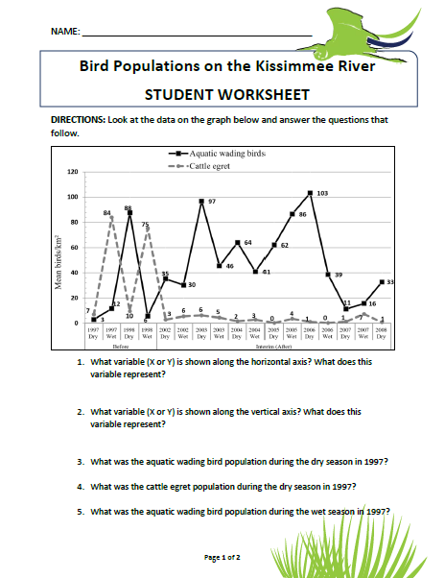
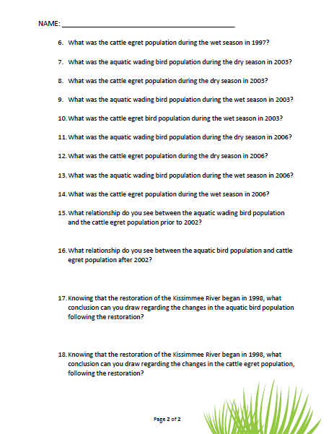
Let’s Look at the Data!
Get into your groups
Work as a team to complete the worksheets

Slide 12
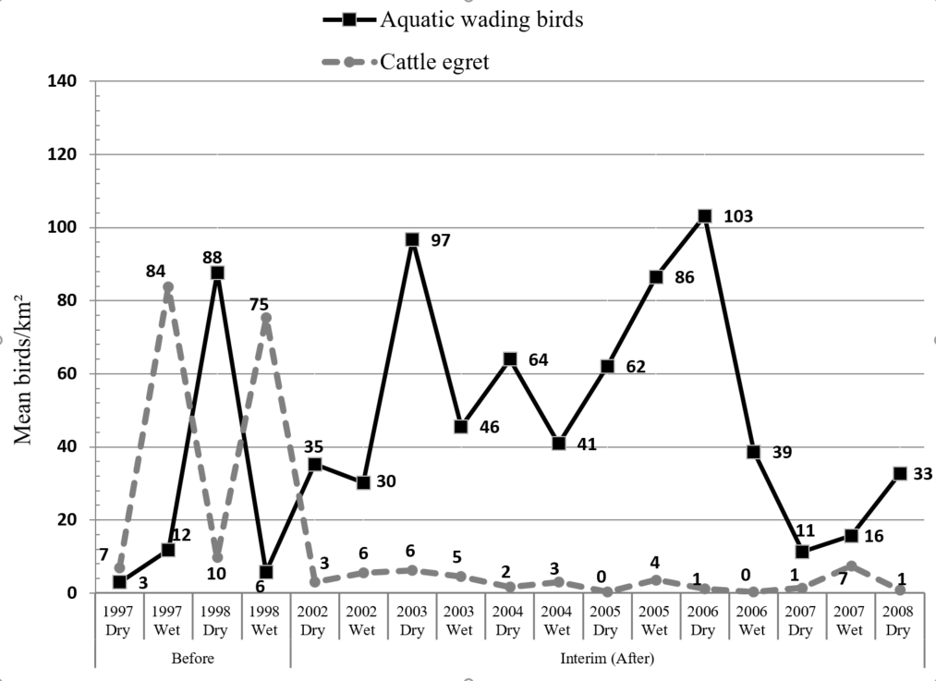
Restoration Impacts on Birds
Comparison of aquatic wading birds and cattle egret before and after restoration.
Notes:
What did your teams notice about the difference between wading birds and cattle egrets before and after restoration?
Almost immediately after the restoration project began, scientists who were monitoring bird populations noted an encouraging increase in the wading bird and waterfowl populations, while also recording a decrease in cattle egret populations. By allowing the floodplain to once again be inundated with water during the wet season, the wetland plant habitats returned, allowing aquatic invertebrates and fish to increase their populations, and enriching the food supply for wading birds.
By allowing the floodplain to once again be inundated with water during the wet season, the wetland plant habitats returned, allowing aquatic invertebrates and fish to increase their populations, and enriching the food supply for wading birds.

