Slide 1
Dissolved Oxygen Levels in the Kissimmee River
Notes:
Dissolved Oxygen (DO) is a measure of the amount of gaseous oxygen dissolved in the water that is available and essential for the survival of aquatic organisms such as fish, reptiles, and amphibians. Very low or very high concentrations of oxygen in the water would not support life and would therefore indicate poor quality.

Slide 2
What is Dissolved Oxygen?
A measure of the amount of gaseous oxygen dissolved in the water that is available for fish and reptiles to breathe
Essential for the survival of aquatic organisms such as fish, reptiles, amphibians
O²

Slide 3
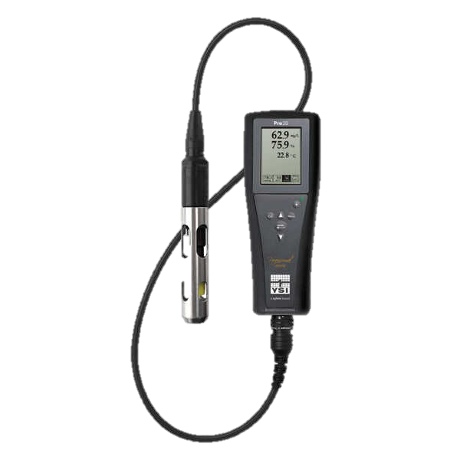
How Scientists Measure DO
Portable hand-held meter with an electrical probe. The probe is placed in the water to determine the amount of dissolved oxygen.
Dissolved oxygen is measured in milligrams per Liter (mg/L) or parts per million (ppm).
1 mg/L = 1 ppm
Notes:
The most commonly used method to measure dissolved oxygen is by using a portable hand-held meter with an electrical probe. The probe is placed in the water to determine the amount of dissolved oxygen. Scientists on the Kissimmee River use a meter called a YSI (which stands for Yellowstone Science Institute).

Slide 4
Range of Tolerance for Dissolved Oxygen
²
Notes:
These instruments provide a measurement of dissolved oxygen in milligrams per liter (mg/L), but can also be measured in parts per million (ppm). 1 mg/L is equal to 1 ppm. Most aquatic life needs a minimum of 3 ppm (parts per million) or 3 mg/L (milligrams per Liter) to survive. At 2ppm (2mg/l), organisms become stressed and can die.

Slide 5
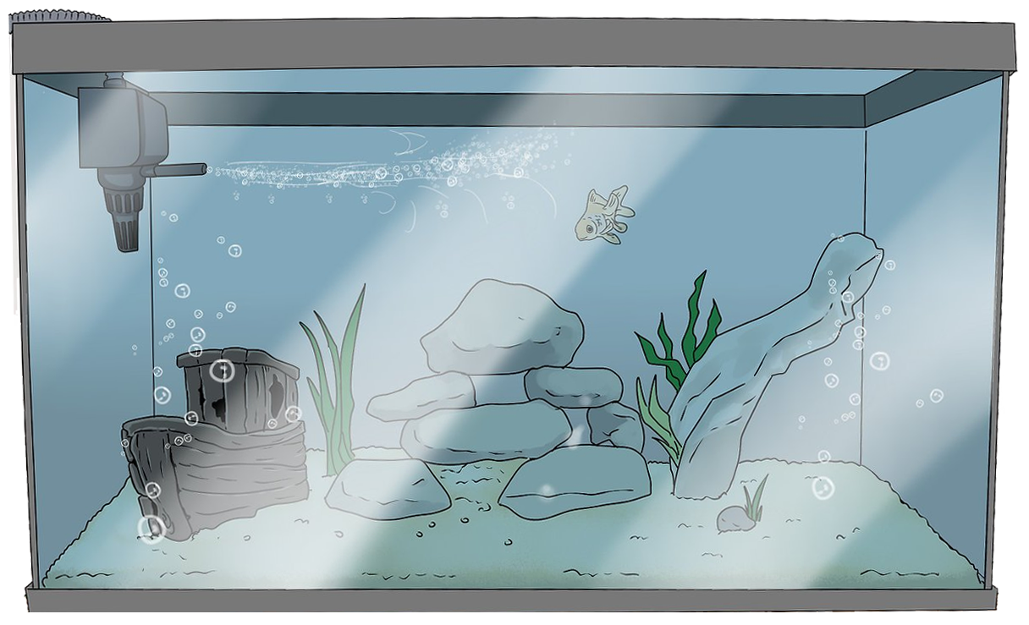
Air pump adds dissolved oxygen in a fish tank
Notes:
In a fish tank, since there are no natural ways for the creation of dissolved oxygen, it must be created artificially with the use of air pumps. These pumps produce the necessary oxygen through the proper amount of aeration.

Slide 6
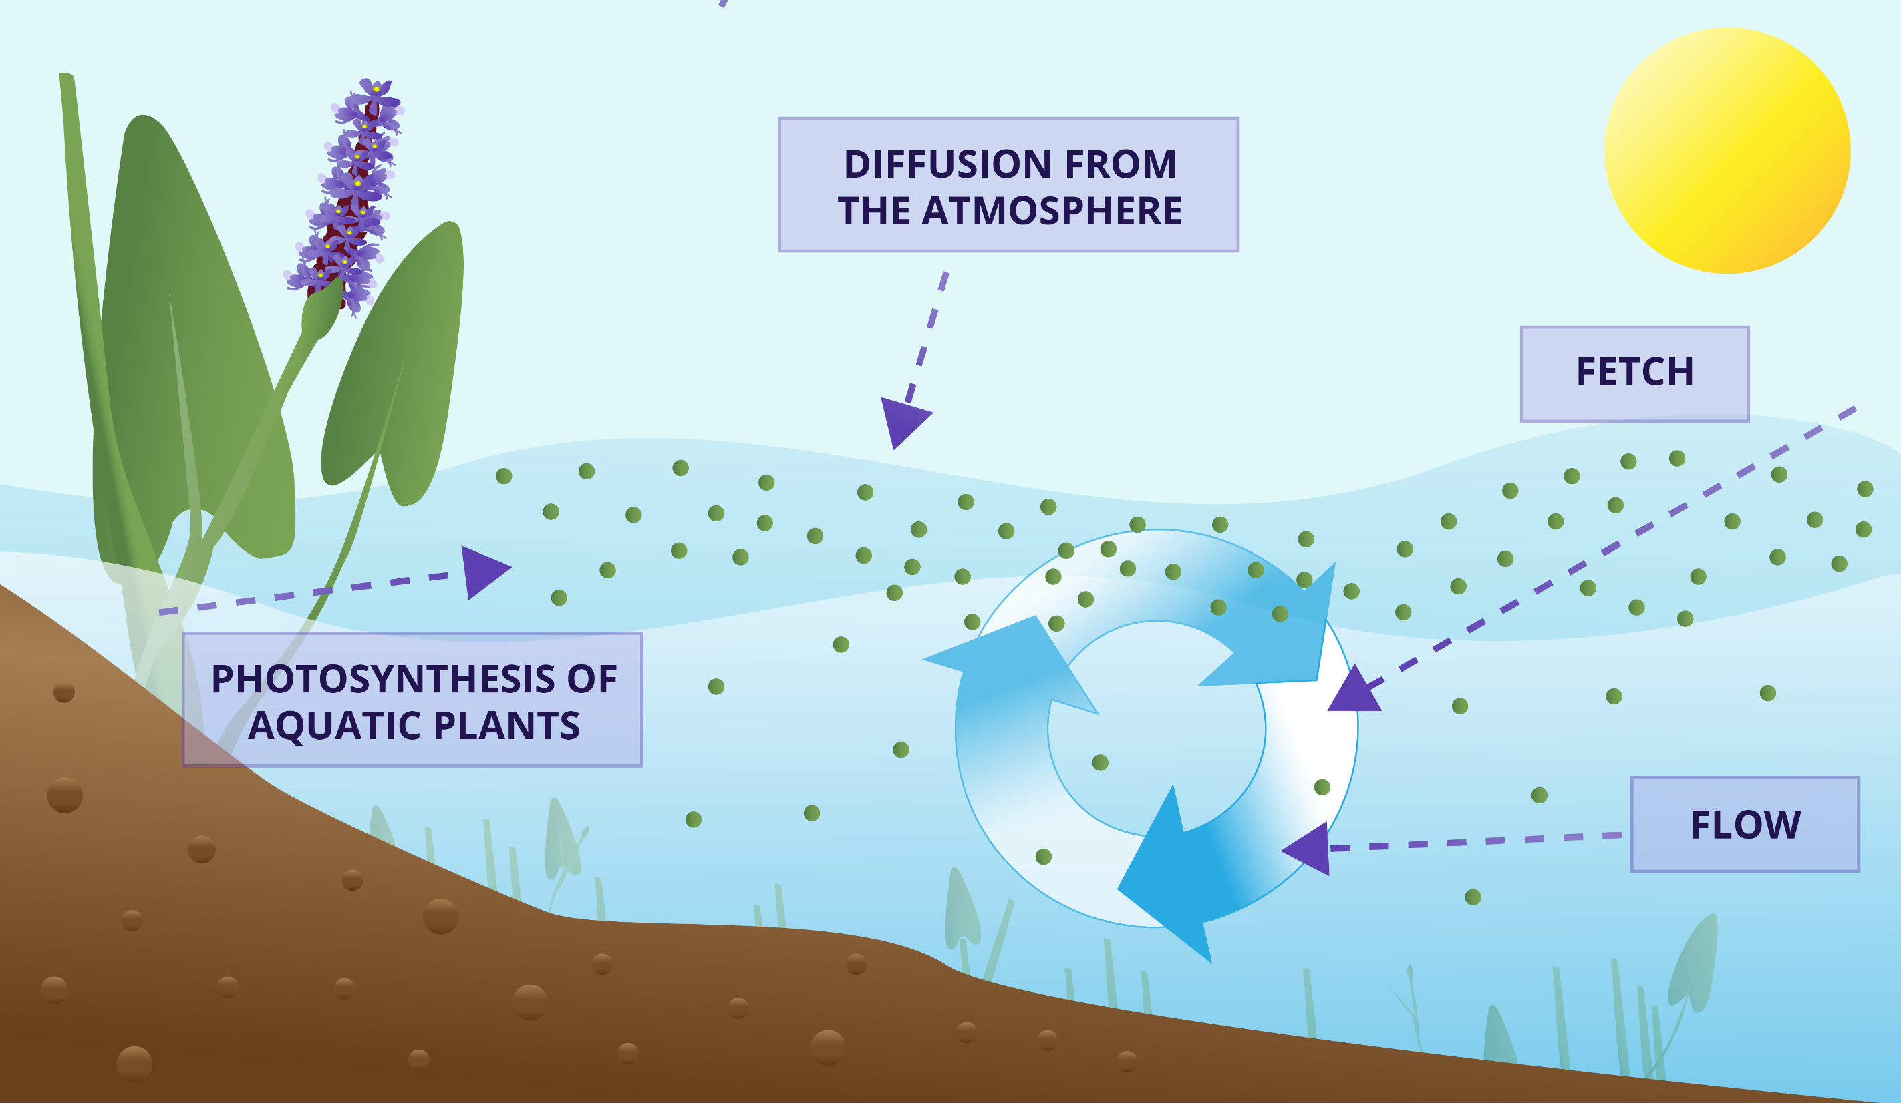
²
Notes:
In the natural world, dissolved oxygen enters the water through several methods including: direct absorption from the atmosphere, the flowing movement of water, or as a waste or by-product of plant photosynthesis. Everything in nature likes to be balanced. Oxygen diffuses into the water’s surface because there is a higher concentration of oxygen in the atmosphere, approximately 21%, while water only has a very small fraction of 1 %. Where the surface of the water meets the atmosphere, oxygen can slowly transfer into the water.
The increase of chaotic changes, known as turbulence, in water flow also allows for greater direct absorption of oxygen from the atmosphere into the water. Factors that affect the rate of turbulence include the weather, water flow, and fetch or the distance water flows over an open area of water.
Photosynthesis is the process where plants make their own food. 6CO₂ + 6H₂O → C₆H₁₂O₆ + 6O₂ is the chemical formula for photosynthesis. This shows that as plants undergo photosynthesis they produce glucose (C₆H₁₂O₆, or sugar) needed for them to survive. It also shows that oxygen (6O₂) is produced. Since this oxygen is not needed by the plants it can be considered a waste product or it can also be considered a by-product being used and absorbed by the water.
Photosynthesis can only occur when light is available. It can only begin when the sun rises and stops when the sun goes down at night.

Slide 7
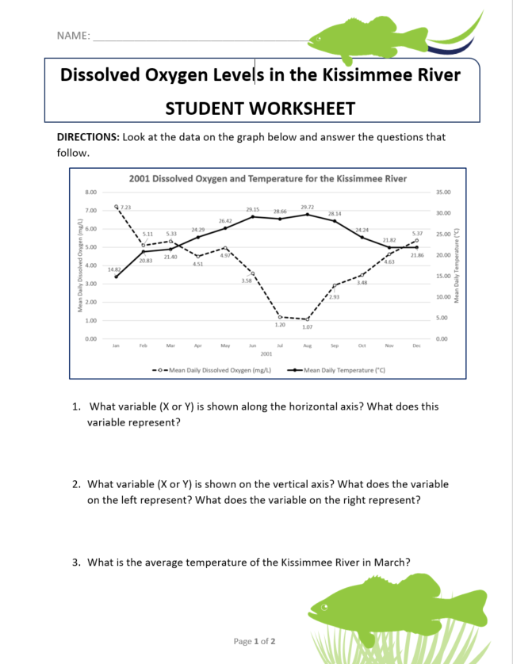
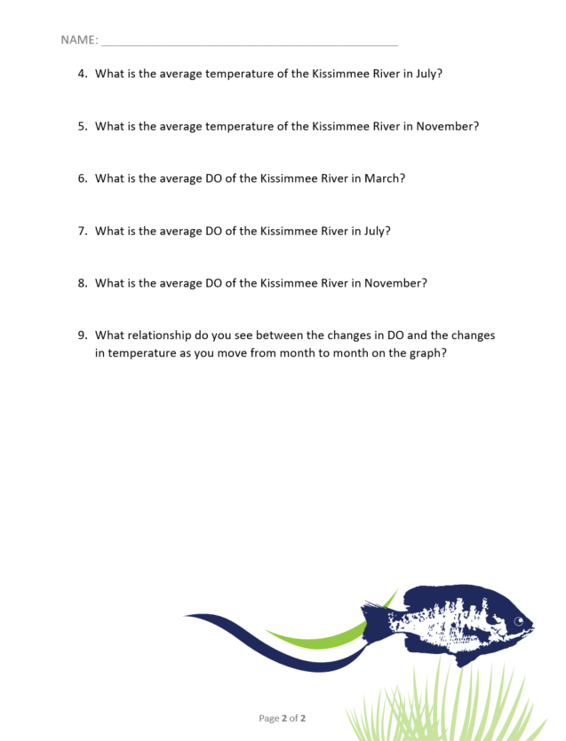
Let’s Look at the Data!
Get into your groups
Work as a team to complete the worksheets

